Slide 1
Digital Twin development for a
DC motor system
Digital Twin show and tell series
Mauricio Calderon, Jairo Viola and YangQuan Chen
MESA (Mechatronics, Embedded Systems and Automation)Lab
Mechanical Engineering, School of Engineering,
University of California, Merced
E: mcalderon32@ucmerced.edu
10/05/2020, Merced, California
Lam Research Corp.

Slide 2
Outline
1
Introduction
2
3
Case study 2: DC motor MIMO system
Case study 1: DC motor system
4
DT for Fault detection
5
Future Works

Slide 3

1. Introduction
DT concept
“A Digital Twin is the combination of multiple, individual, and detailed simulation models (continuous, discrete, hybrid), where its interconnection represents the dynamics of a complex system, which is updated periodically (receding horizon or real time ) with the system information in order to reflect the system current status as well as predict its future behavior and possible faults ”.
^{MESA Lab, UC Merced}
Virtual representation of the system
High detail modelling
System life cycle estimation
Interconnected system dynamic
IoT and edge computing data acquisition

Slide 4
1. Introduction
DT components

Slide 5
1. Introduction
Most of our MESALab
Systems are here
4 levels of Digital Twin [14]
Level | System modelling | Physical system | System interaction | Smart capabilities | Features
I | Digital Twin Environment | Not built | Not built | Not apply | Preliminary design
II | DT environment based on the real system | Operating standalone | Non-real time data acquisition | No | Performance analysis and system status
III | DT environment with monitoring interface and fault detection Capabilities | Operating standalone with supervision systems | Real time data acquisition | Limited | Data analytics, fault detection, prognosis
IV | DT environment with monitoring interface, and adaptive behavioral learning | Operating in the loop with the DT virtual environment | Real time data acquisition and smart control | Total | Data analytics, Fault detection, prognosis, Automated recommendations, Automated actions over the physical system

Slide 6

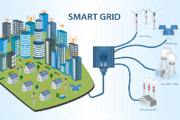
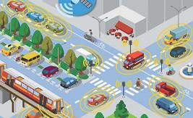

1. Introduction
DT Applications
Smart city
Smart grid
Smart transportation
Smart manufacturing

Slide 7





1. Introduction
DT development framework
4. DT assembly
And
Behavioral
matching
2. System
Documentation
1. Target system definition
3. Multidomain Simulation
5. DT validation
And deployment

Slide 8





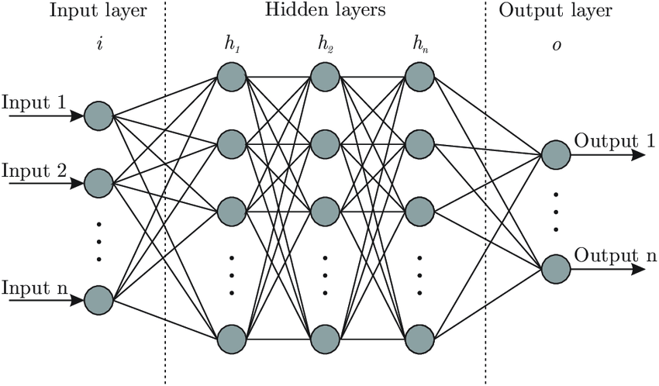
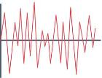

1. Introduction
Multidomain simulation
Data
streams
Output
Digital Twin

Slide 9
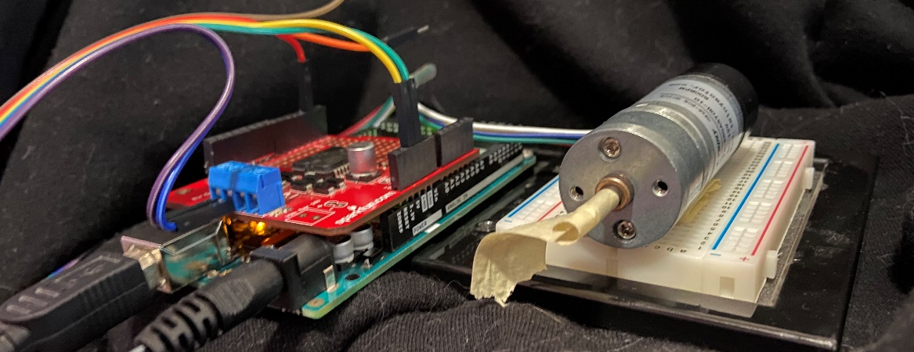
2. Case study: DC motor system
System description
DC motor 12v 600 RPM
Arduino mega with ardumotor shield
Rotational encoder 120 ppr
External power supply
Running real time embedded control using C code generation for Arduino

Slide 10
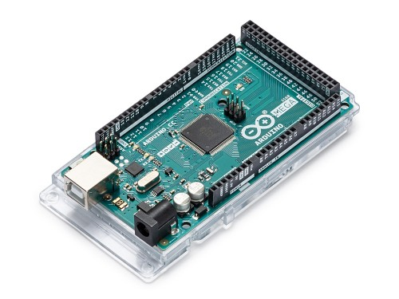
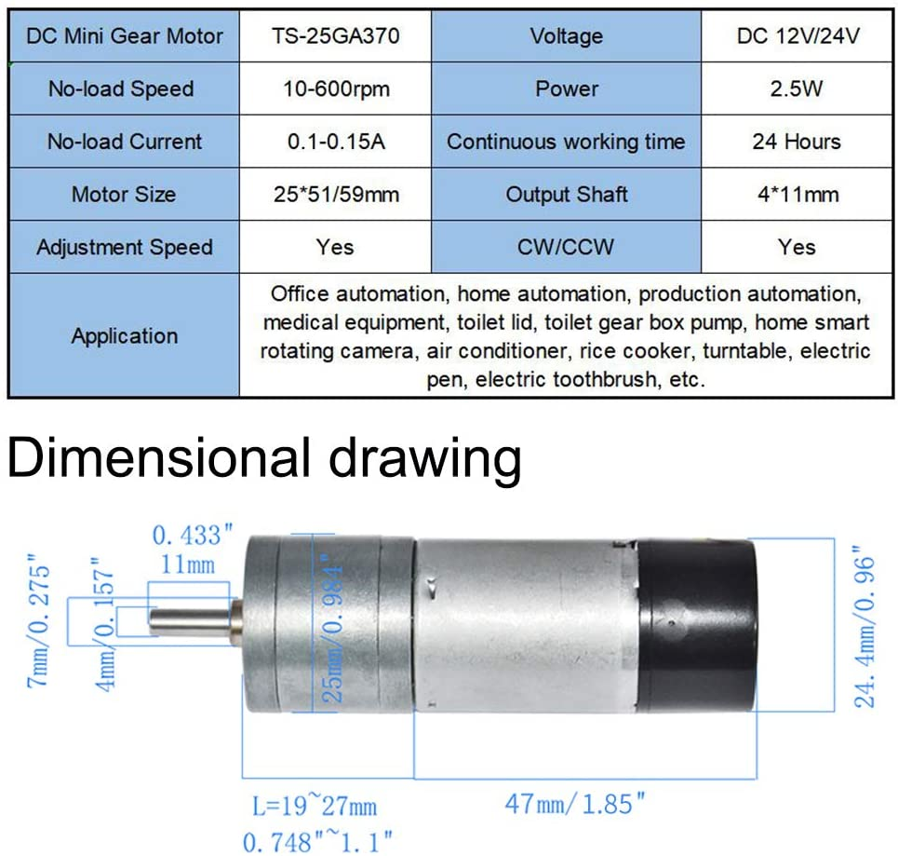
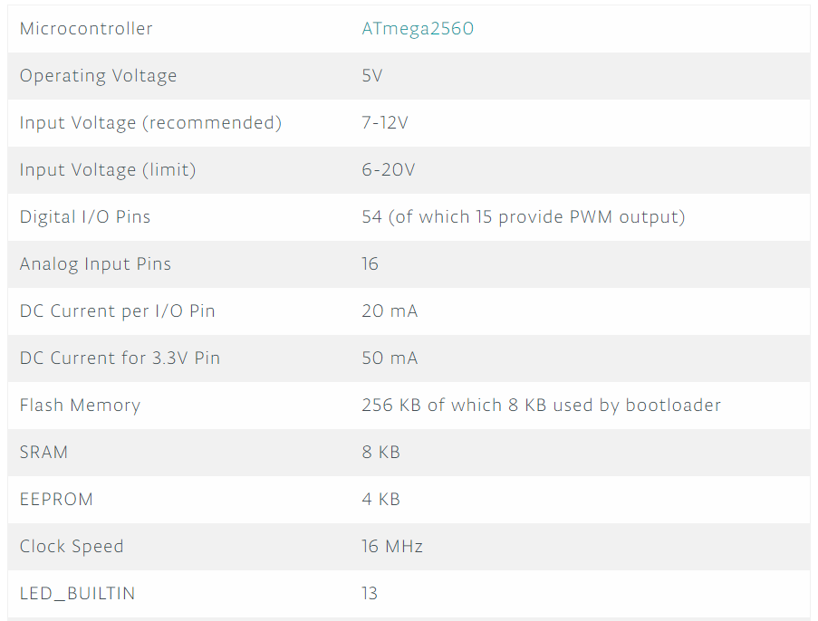
2. Case study: DC motor system
System documentation
Arduino mega
DC motor with encoder

Slide 11
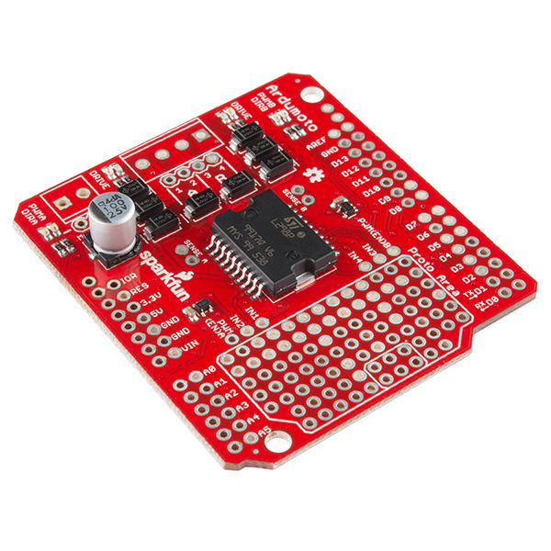
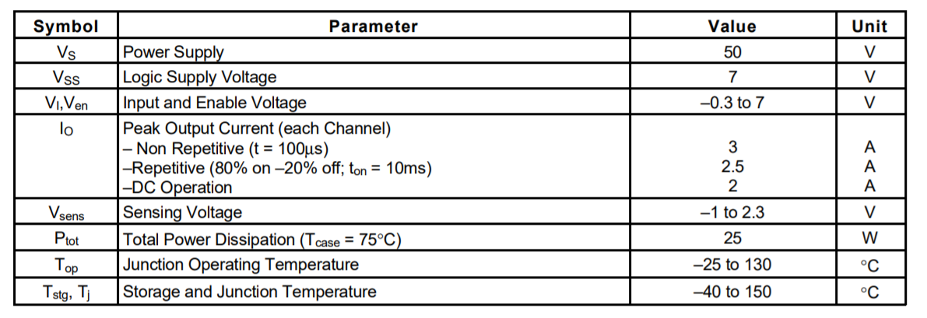
2. Case study: DC motor system
System documentation
DC motor Power driver

Slide 12

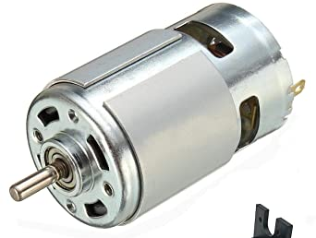
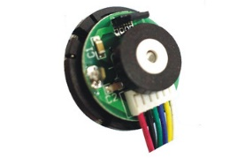
2. Case study: DC motor system
Open loop configuration
r
y
Motor driver
DC motor
Motor encoder

Slide 13
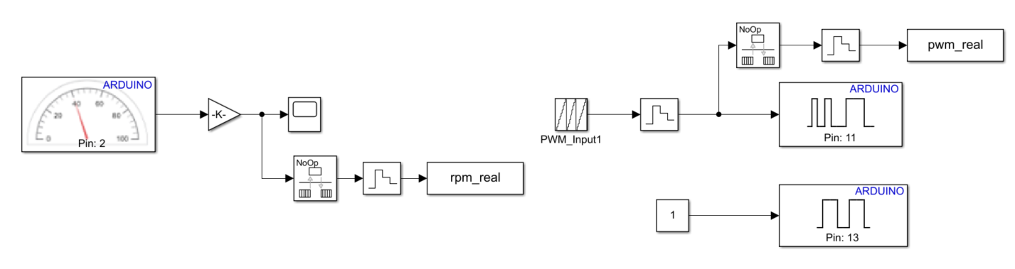
2. Case study: DC motor system
DC motor open loop configuration (Velocity)

Slide 14
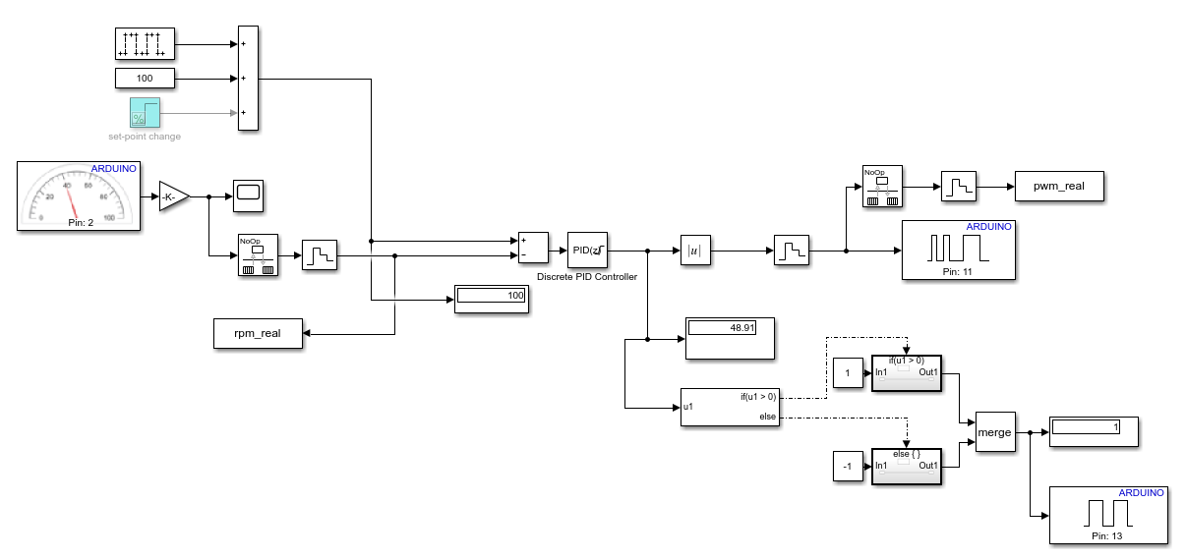
2. Case study: DC motor system
DC-motor closed-loop configuration (Velocity)

Slide 15
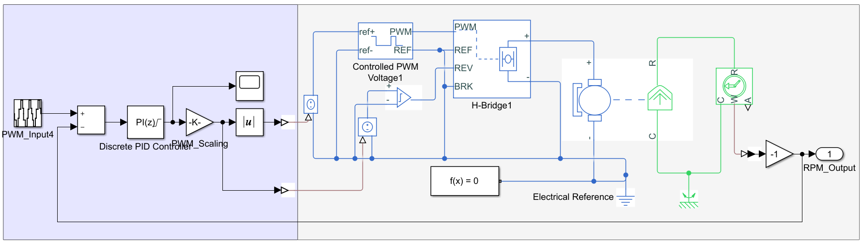


2. Case study: DC motor system
Digital Twin model in Simscape®
Digital domain
Electrical domain
Mechanical Domain
Software tools

Slide 16
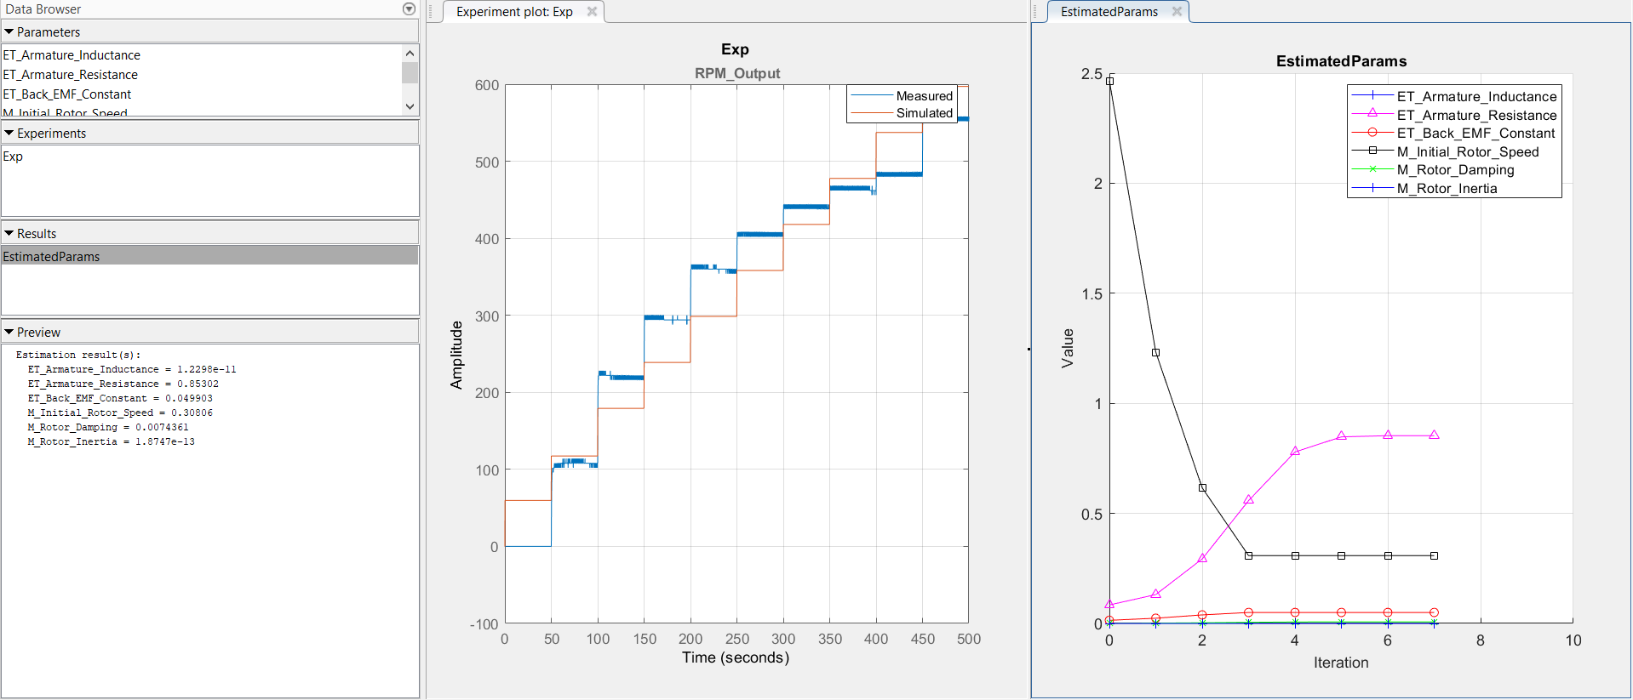
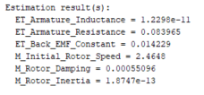
2. Case study: DC motor system
SLDO( Simulink Design Optimization) Parameter Estimation
Roboholics (manufacturer)

Slide 17

2. Case study: DC motor system
DT behavioural matching
“Find the parameters of each subsystem composing the Digital Twin in order to fit its complete system dynamics, coinciding match with the real state of the physical system”
DT subsystems
parameters
Physical system
I/O Data
Optimized
DT subsystems
parameters
Optimization
loop
Digital Twin
DT output
I/O error minimization

Slide 18
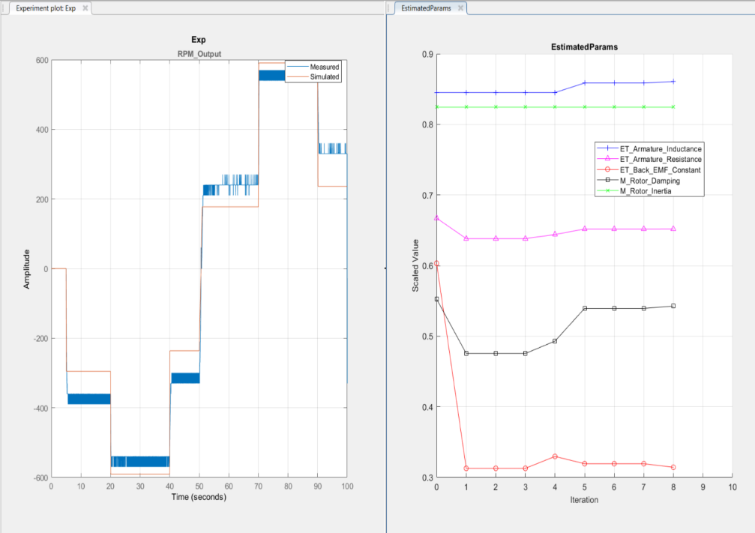
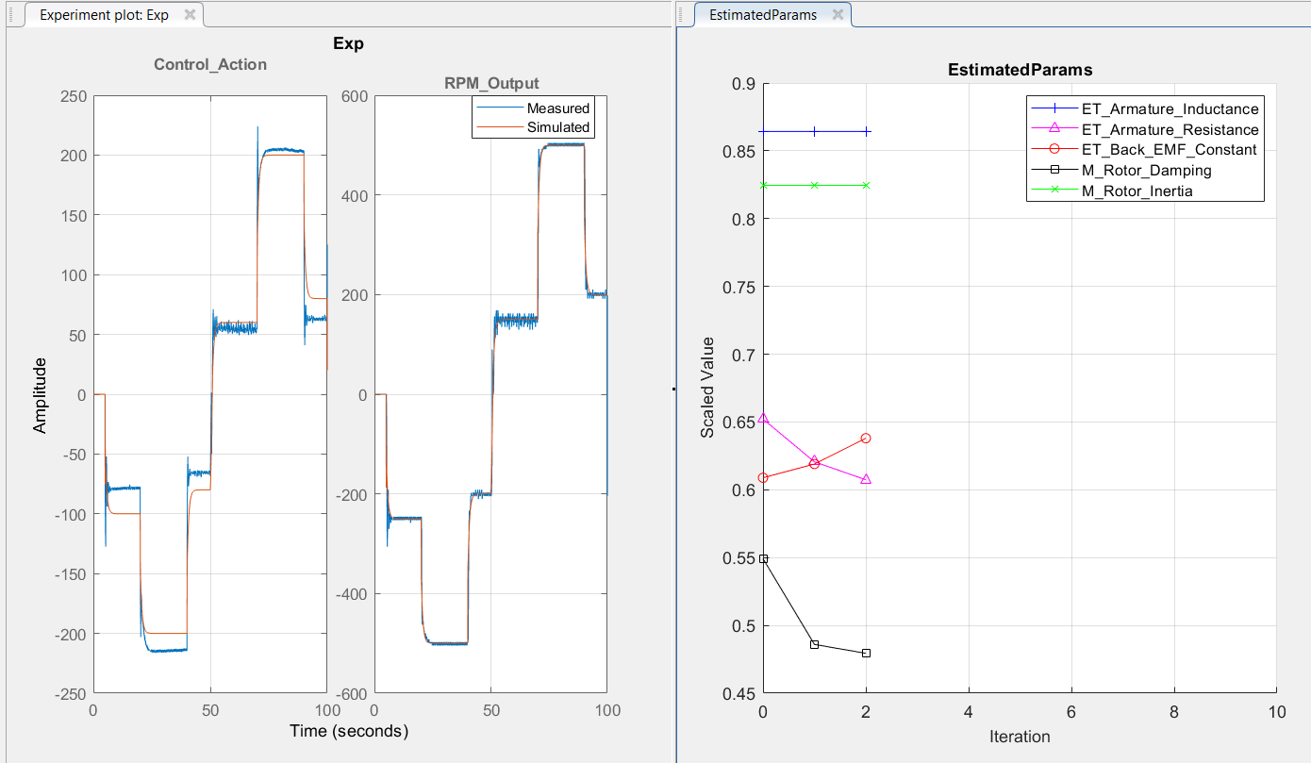
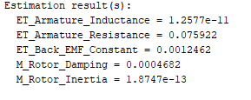
2. Case study: DC motor system
Digital Twin behavioural matching
Open loop
Fine tuning in closed loop
Matlab parameter estimation
toolbox Parameters estimation

Slide 19
2. Case study: DC motor system
Closed loop response of Digital Twin vs Physical asset
Time response
Control action

Slide 20
2. Case study: DC motor system
Fault Detection
Power supply interruption due to a motor driver malfunction at t=50 s
Time response
Control action

Slide 21


2. Case study: DC motor system position control
Closed loop configuration
r
e
PID
y
+
-
PID controller
Motor driver
DC motor
Motor
Backslash
Monitored by Simulink
external execution mode
Motor encoder
(Angular position feedback)

Slide 22
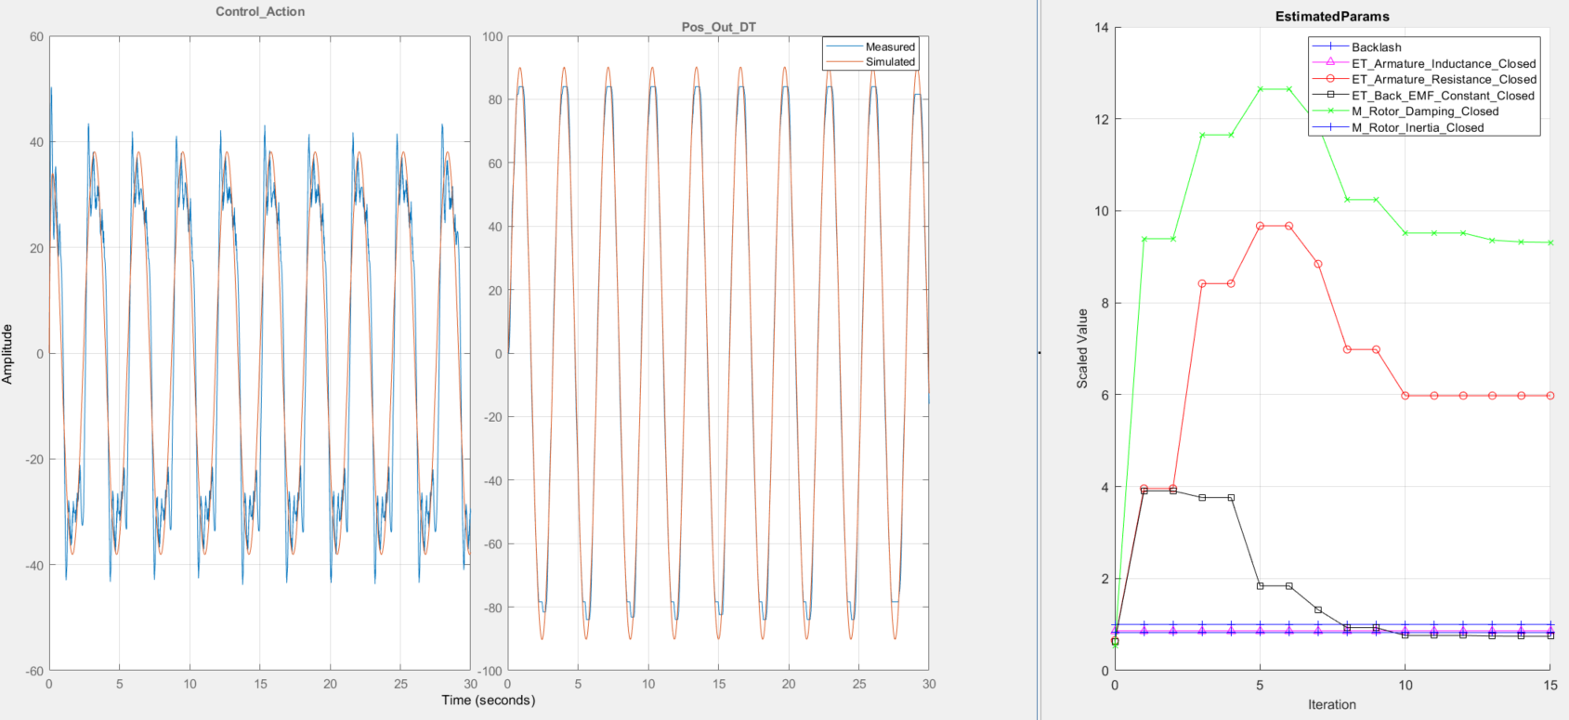
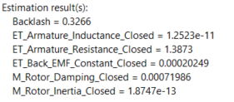
2. Case study: DC motor system position control
Behavioural matching

Slide 23
2. Case study: DC motor system position control
Closed loop response of Digital Twin vs Physical asset
Time response
Control action

Slide 24
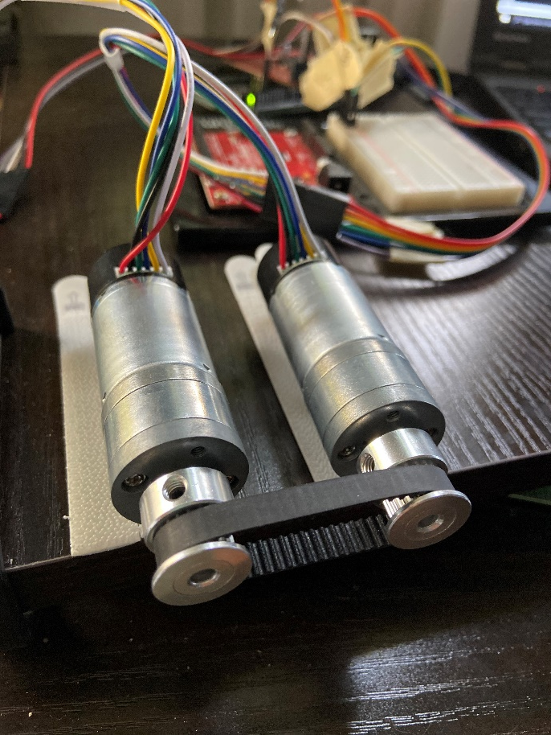
3. Case study: DC motor MIMO system
System description
2xDC motor 12v 600 RPM
Arduino mega with ardumotor shield
2xRotational encoder 460 cpr
External power supply
Running real time embedded control using C code generation for Arduino

Slide 25
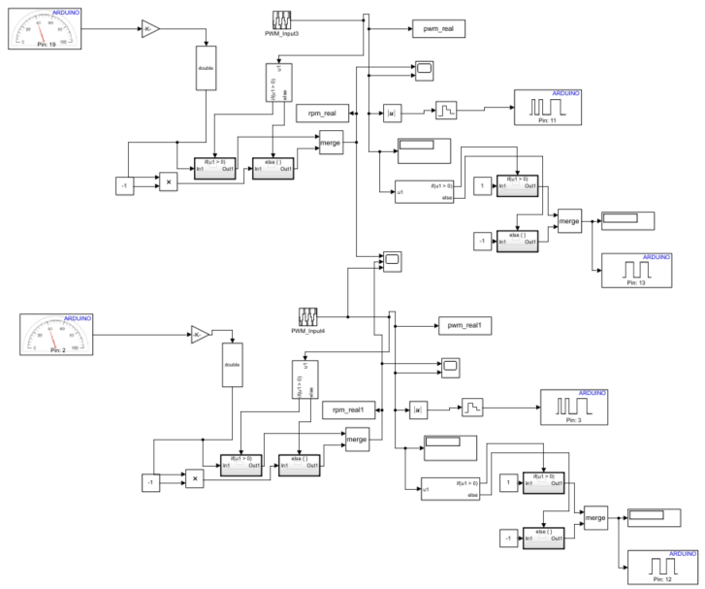
3. Case study: DC motor MIMO system
Real System Open Loop (velocity)
Tachometer from Simulink library do not allow to consider interrupt priority
Is necessary to develop an S-Function that handle the interaction with the real system

Slide 26
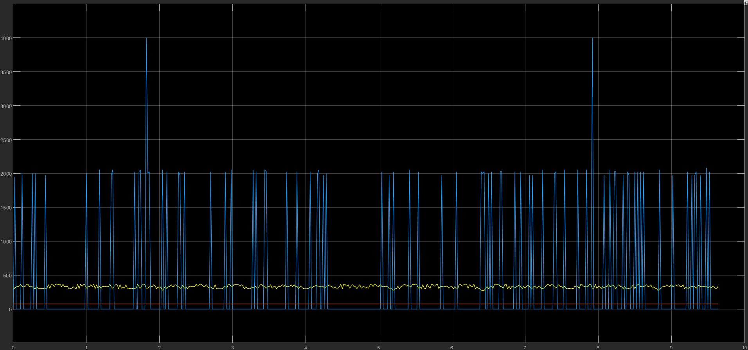

3. Case study: DC motor MIMO system
Real System Open Loop
M1
M2
Set-Point

Slide 27
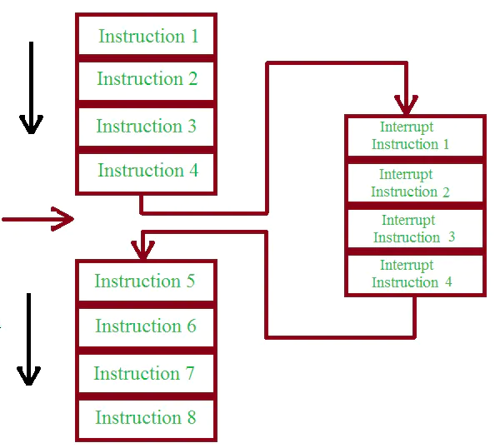
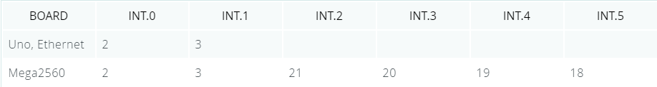
3. Case study: DC motor MIMO system
Developing Encoder –S-function
Interrupts are useful for making things happen automatically in microcontroller programs and can help solve timing problems
We need to use interrupts to count pulses from encoder, since pulses arriving very fast
An ISR cannot have any parameters, and they shouldn’t return anything.
only one ISR can run at a time, other interrupts will be executed after the current one finishes in an order that depends on the priority they have
Program Flow
Interrupt Event
ISR
Program Flow

Slide 28
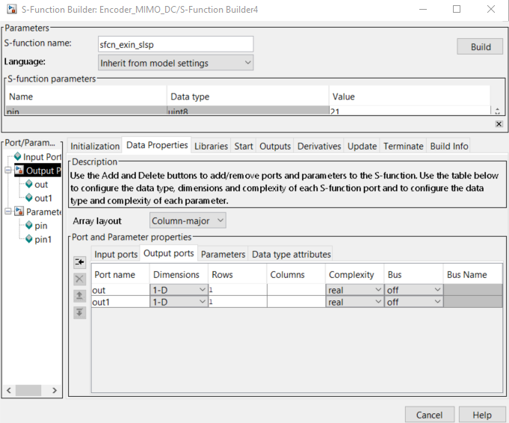
3. Case study: DC motor MIMO system
Developing Encoder S-function
The S-Function builder block creates a C-MEX S-function from our supplied C code with multiple input port, output ports and a variable number of scalar vector or matrix parameters
the Data Proprieties pane, allows us to define the number and dimensions of input and output ports as well as the parameters passed to the S-Function block
This block also can be used with Simulink Coder for code generation

Slide 29
3. Case study: DC motor MIMO system
Developing Encoder S-function
Variable declarations
Void Setup
Void Loop
ISR
Arduino Ide
Libraries pane
Update
pane
Outputs
pane
Libraries
pane
S-function

Slide 30
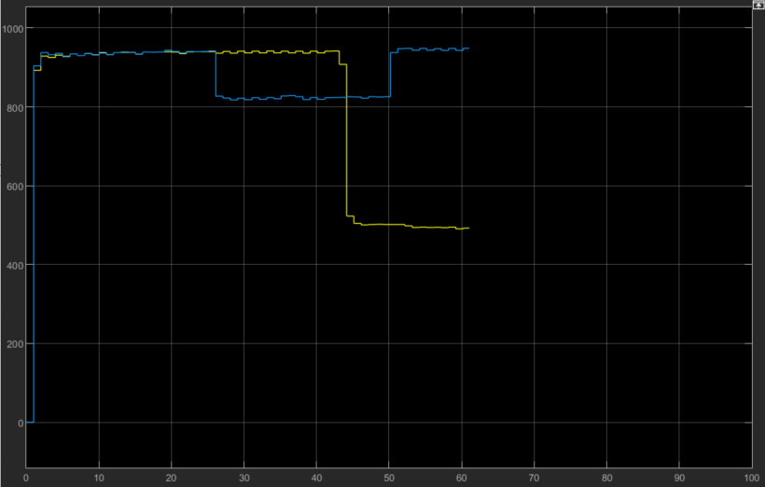
3. Case study: DC motor MIMO system
Open Loop Testing
Using Simulink Block
Using S-function
M1
M2

Slide 31
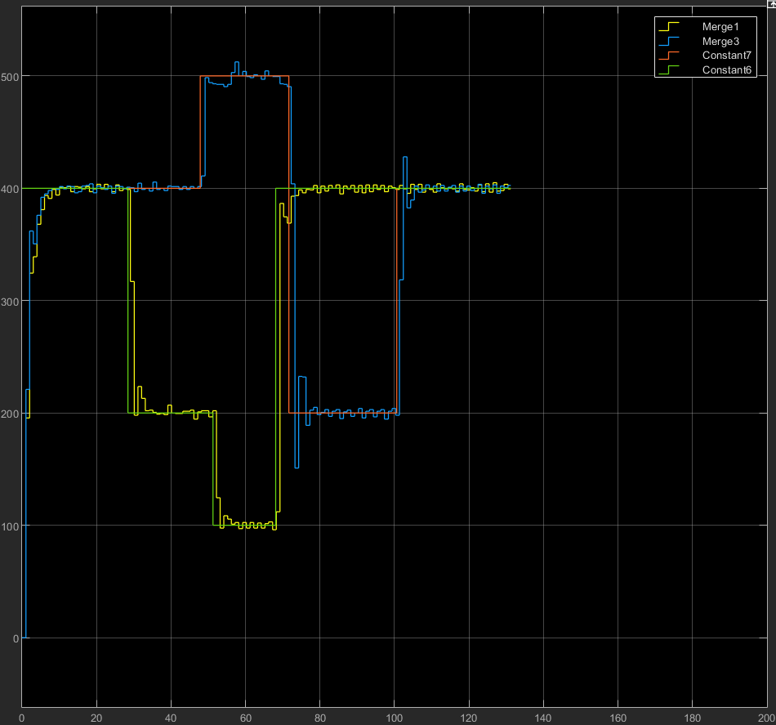
3. Case study: DC motor MIMO system
Closed Loop Testing
The motors are no longer influencing each others behaviors as happened while using the Simulink Tachometer block

Slide 32
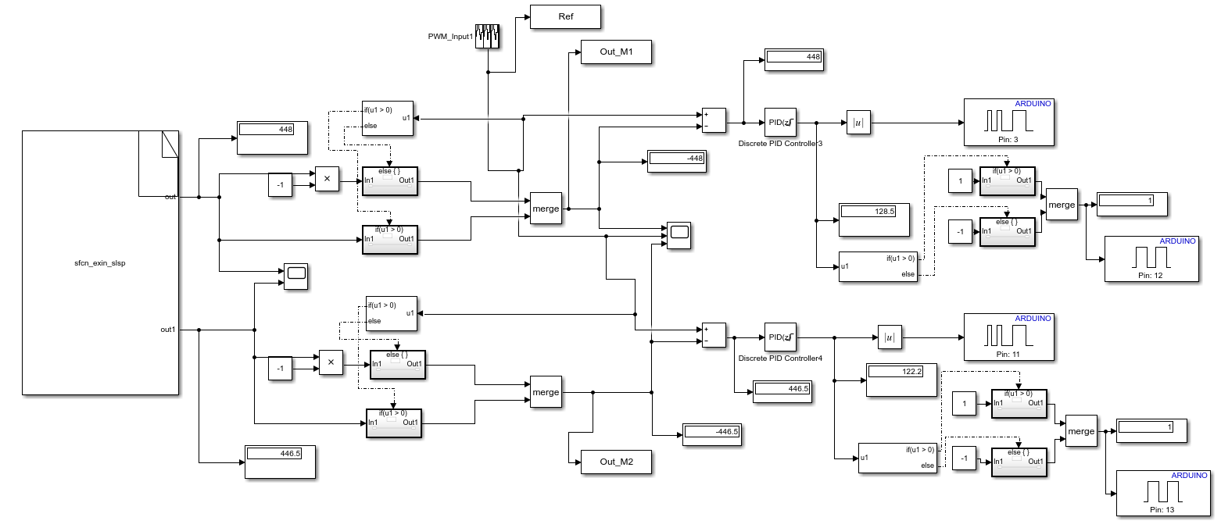
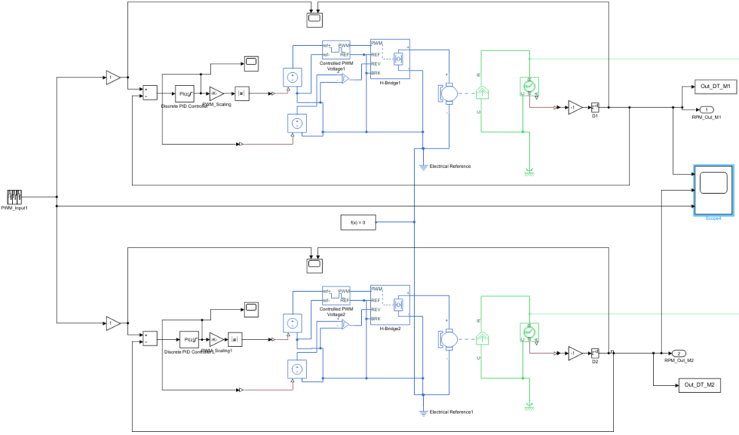
3. Case study: DC motor MIMO system
Closed Loop Testing
Simulink Diagram for Physical Sys
Simulink Diagram for Digital Twin

Slide 33
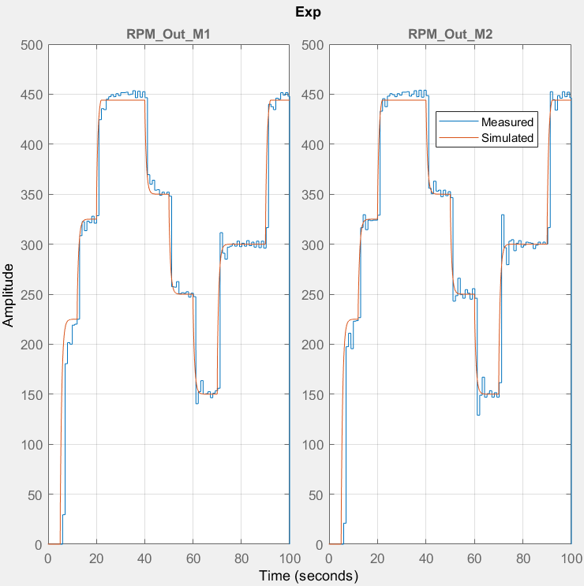
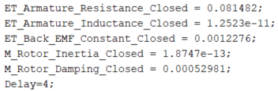
3. Case study: DC motor MIMO system
Physical Response VS Digital response
DC motors parameters

Slide 34
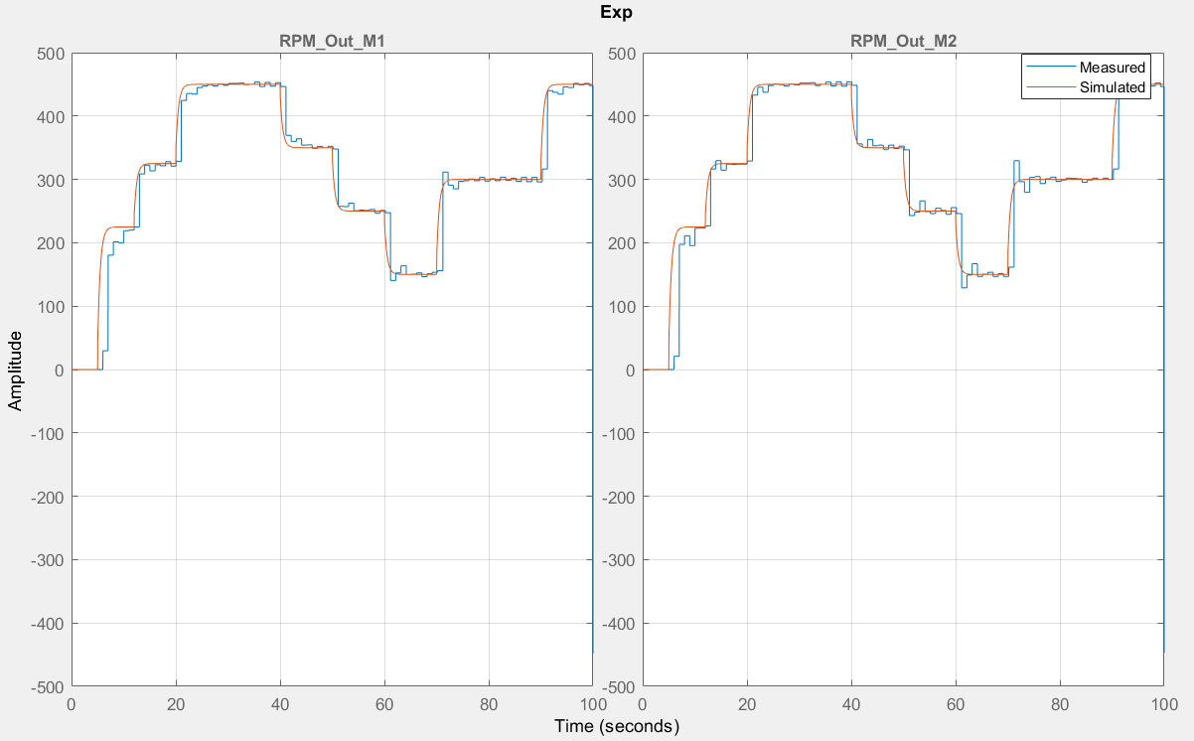
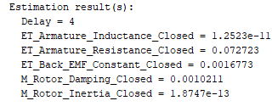
3. Case study: DC motor MIMO system
Behavior Matching results
DC motors parameters

Slide 35
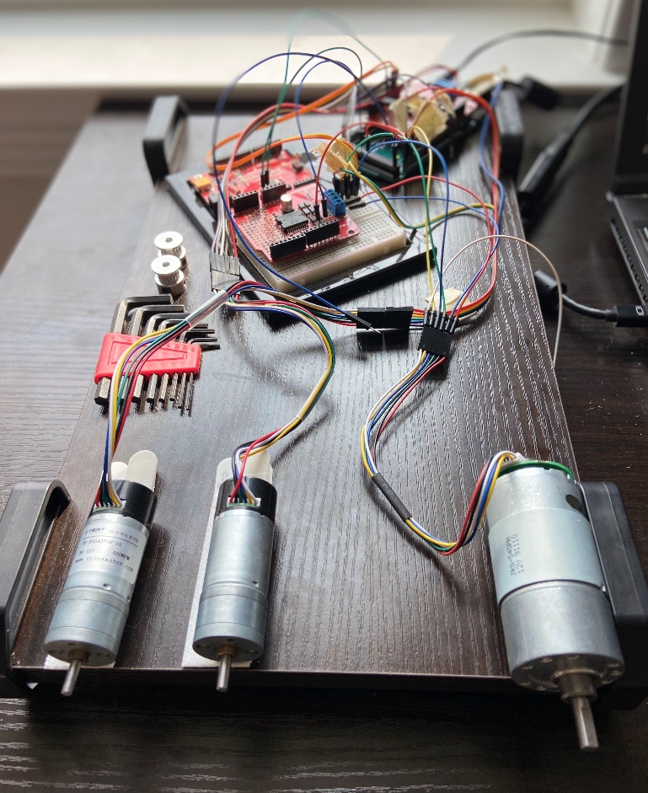
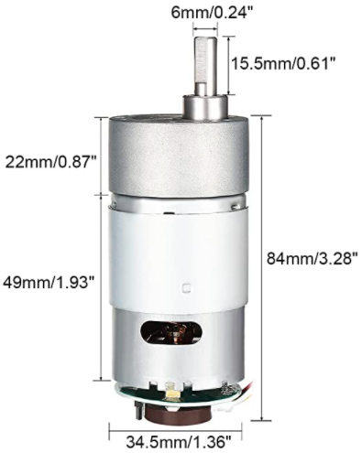
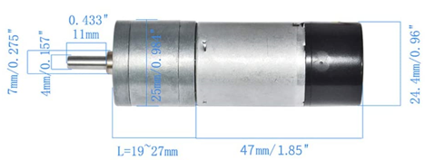
3. Case study: DC motor MIMO system
3 DC Motors
Aslong DC motor
12V
200 RPM
Tsiny DC motor
12V
600 RPM

Slide 36
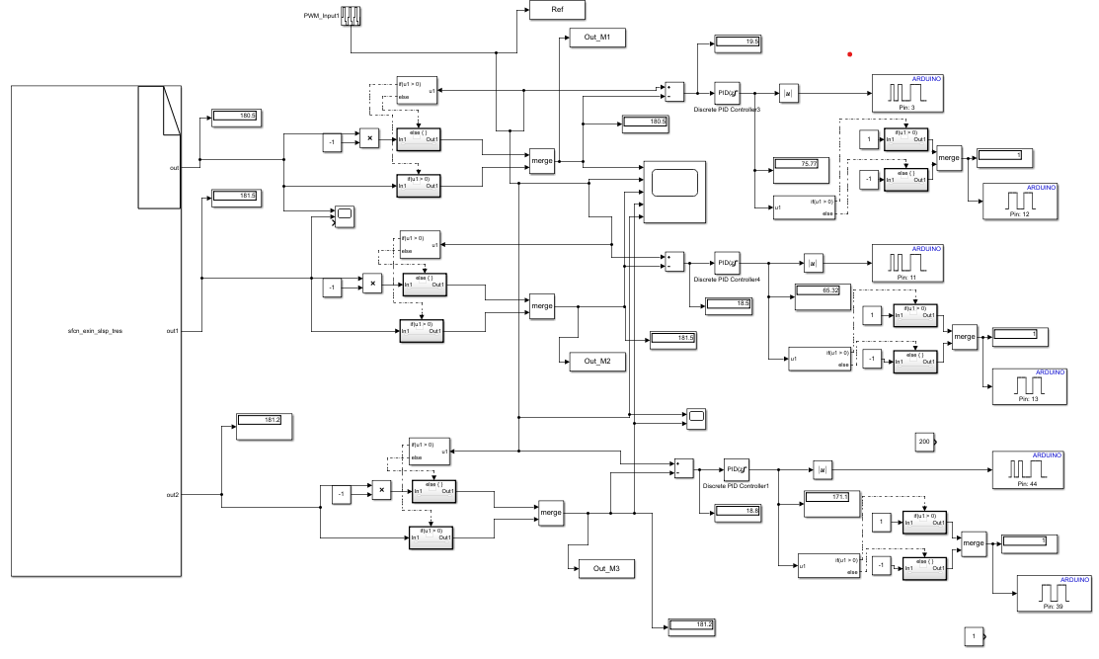
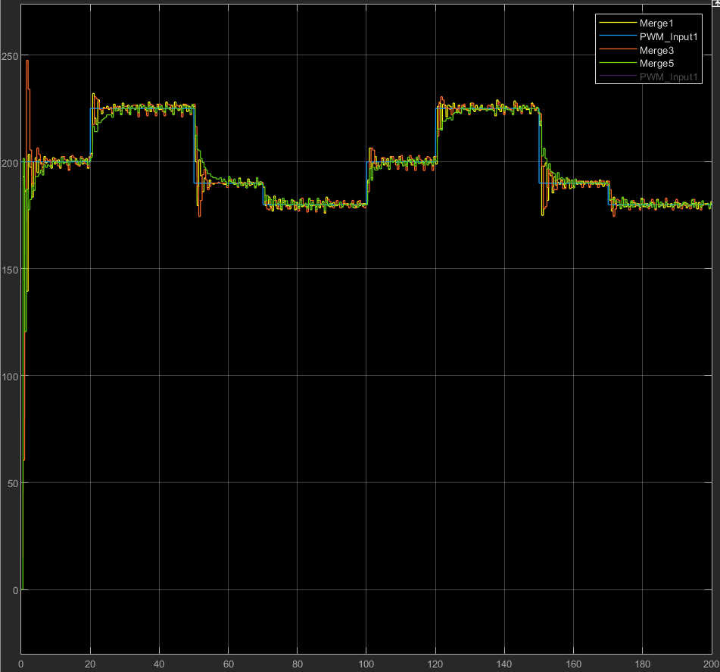
3. Case study: DC motor MIMO system
Physical Response

Slide 37
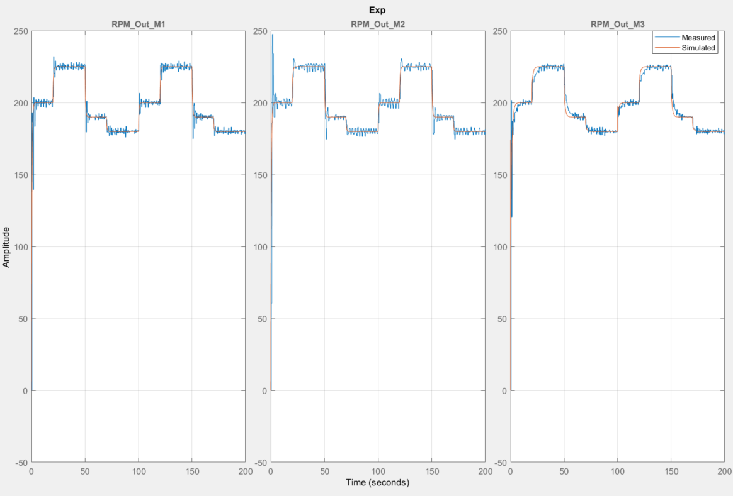
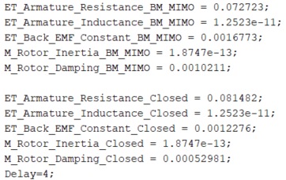
3. Case study: DC motor MIMO system
Physical Response VS Digital response
DC motors parameters

Slide 38
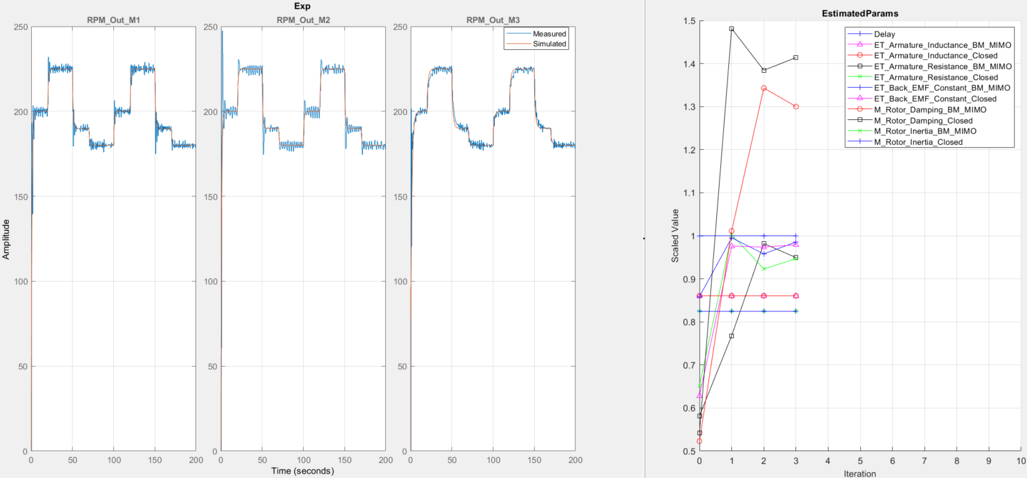
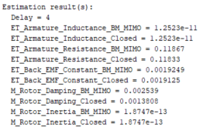
3. Case study: DC motor MIMO system
Behavior Matching results

Slide 39
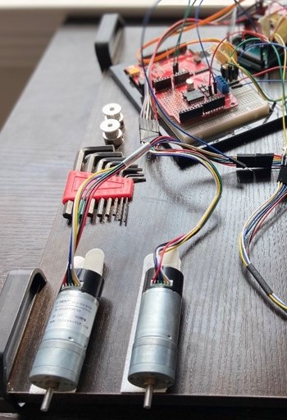
3. Case study: DC motor MIMO system
2 DC Motors – Position Problem
Tsiny DC motor
12V
460 CPR

Slide 40
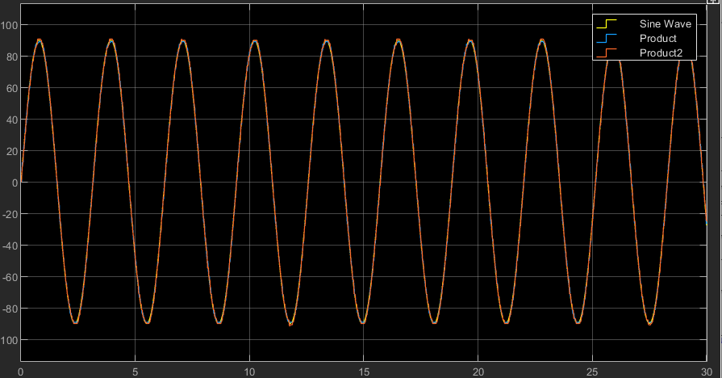
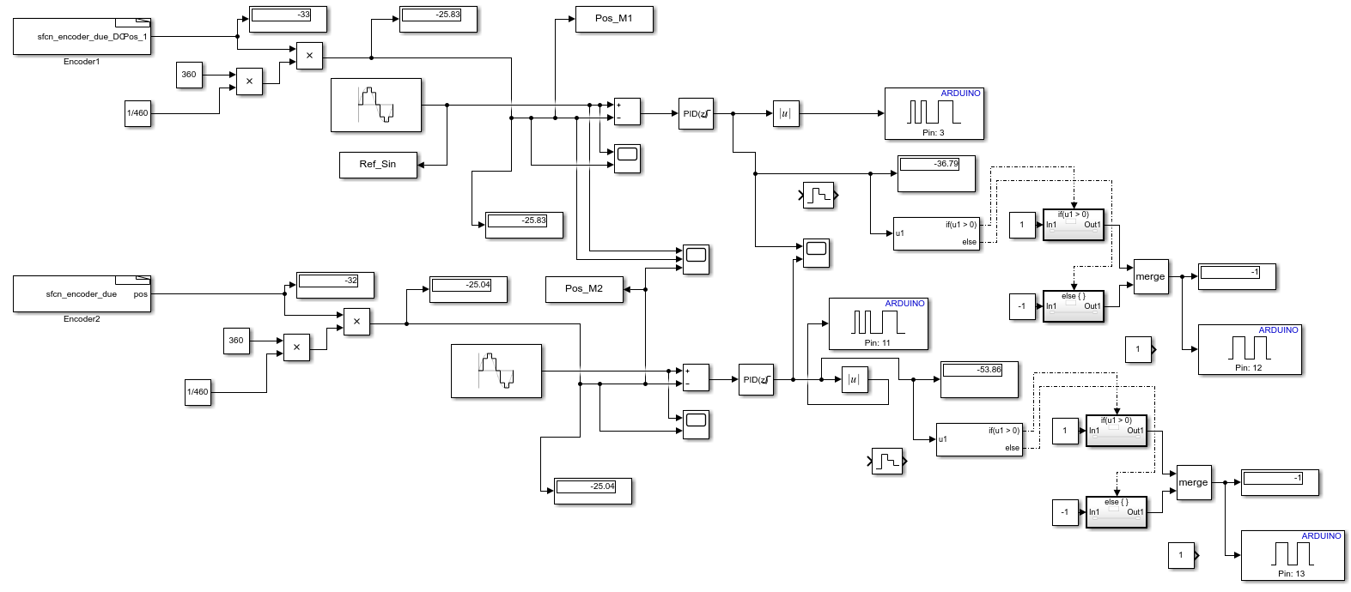
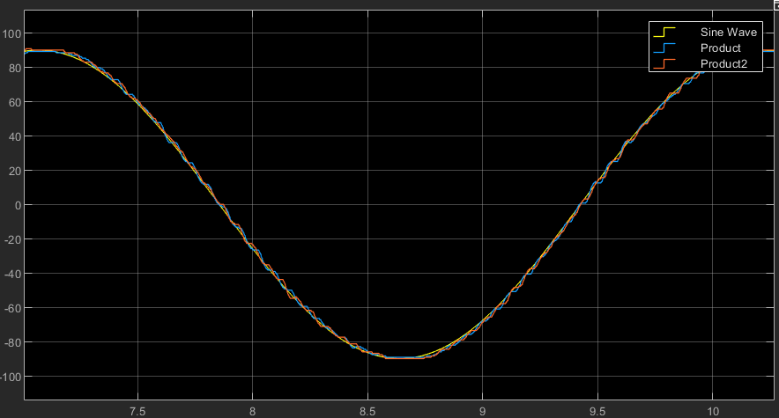
3. Case study: DC motor MIMO system
Physical Response

Slide 41
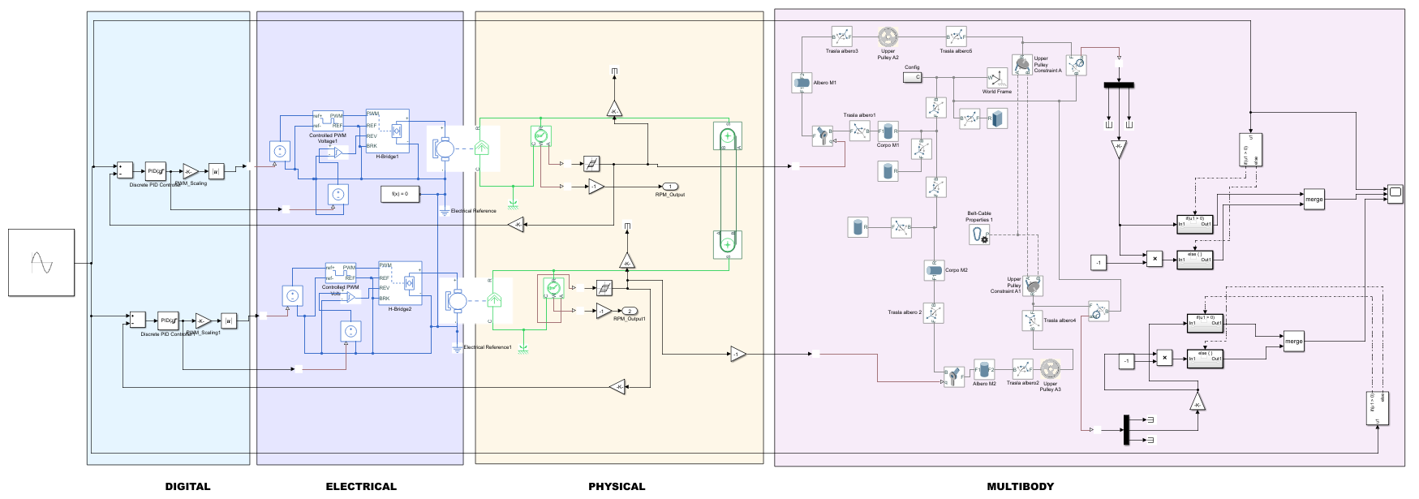
3. Case study: DC motor MIMO system
Digital Twin model in Simscape

Slide 42



3. Case study: DC motor MIMO system
Digital Twin 3D model (Simscape Multibody®)

Slide 43

3. Case study: DC motor MIMO system
DT vs Real Response

Slide 44


3. Case study: DC motor MIMO system
SLDO( Simulink Design Optimization) Parameter Estimation

Slide 45

3. Case study: DC motor MIMO system
DT vs Real Response

Slide 46

4. Fault detection
Fundamental definitions
Faults
Unpermitted deviation of at least one key feature of the system
Failure
Permanent interruption of system operation under desired conditions
Malfunction
Intermittent irregularity of the system desired function

Slide 47





4. Fault detection
Closed loop system faults
Fault 1: actuator
$$r(t)$$
$$e(t)$$
PID
Controller
$$u(t)$$
Actuator
$$\hat{u}(t)$$
Process
$$y(t)$$
+
-

Slide 48

4. Fault detection
Digital Twin with fault capabilities
F1
F1 enabled via relay in the physical system
White Gaussian noise

Slide 49




4. Fault detection
Start
Fault detection: Statistical threshold
$$define:DTLIM1 \& DTLSM1$$
Detect faults based on $3σ$ from the control error normal distribution
DTLSM1=3*Std_Err_M1+Mean_Err_M1;
DTLIM1=-3*Std_Err_M1+Mean_Err_M1;
$$DTLIM1≤E_M1≤DTLSM1$$
Actuator fault
Nominal
end

Slide 50




4. Fault detection
Fault detection: modelling control error (Normal distribution)
Histogram control error M1
Fitdist: fit Probability distribution
Histogram control error M1

Slide 51


4. Fault detection
Fault Detection in Real system
Position Output
F2
F1
Control error
F1
F2

Slide 52


4. Fault detection
Fault Detection in Digital Twin
Position Output
F2
F1
Control error
F1
F2

Slide 53
3. Conclusions and future work
The Digital Twin of a DC motor system for speed and position control has been developed using simscape for Multiphysics dynamic representation of the system behavior
Obtained results shows that the Digital Twin represents properly the behavior of the real asset
A fault detection methodology is implemented and have been show that the DT follows the dynamics of the real system
A behavorial matching is performed in order to determine the system Multiphysics coefficients for the DC motor and the other elements of the system.
Digital Twin is a detailed virtual representation of a real system, which is an emerging technology with significant benefits towards Industry 4.0

Slide 54
3. Conclusions and future work
Extend DT capabilities
Implement CPA metrics
Real time analytics
DT for developing complex
controllers
For the DC motor system the next consideration should be addressed:
Build a supervisory interface for DT monitoring and performance assessment
Setup a MIMO configuration for the DC motor system
Test new online fault detection algorithms (adaptive sliding window, fast fourier transform, neural network)
Develop cloud interface for running the real time DT and analytics
Embedded DT into an Edge device
(Rpi C++)
Data driven control techiques (I-PID)
Data driven system ID
(Dyamic Mode Decomposition)
Edge Digital Twin
DT for complex systems

Slide 55


Thanks for your attention!

