Slide 1
Single Peltier temperature control system with real-time thermal vision feedback towards Smart Control Engineering
Digital Twin show and tell series
Jairo Viola
MESA (Mechatronics, Embedded Systems and Automation)Lab
Mechanical Engineering, School of Engineering,
University of California, Merced
E: jviola@ucmerced.edu
06/01/2020, Merced, California

Slide 2
Outline
1
Introduction
2
3
Building a DT from scratch
4
Study case: SISO Peltier system
Digital Twin (DT)
5
Next steps

Slide 3
Part 1: DT background

Slide 4

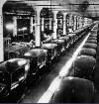
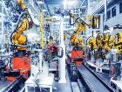
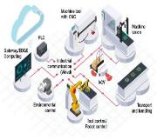
1. Introduction
Industry 4.0: Smart Factory
Beginning of
20th Century
Internet of Things
Cyber physical systems
Multiagent interaction
Smart manufacturing
Cloud Computing
18th Century
1970s – 2000s
Industry 4.0
Industry 1.0
Steam powered machines
Industry 2.0
Electricity powered machines
Industry 3.0
First Assembly line
Mechanical production facilities
Computer automated manufacturing
Improved quality and manufacturing
Pipeline production

Slide 5


1. Introduction
Industrial Artificial intelligence
Characteristics
“Industrial AI is any application of AI relating to the physical operations or systems of an enterprise. Industrial AI is focused on helping an enterprise monitor, optimize or control the behavior of these operations and systems to improve their efficiency and performance”¹
Resilience
Fault tolerant
On demand manufacturing
Self organizing
Agents Synergy
¹CloudPulse 2017 Strategies Artificial Intelligence for Industrial Applications

Slide 6



1. Introduction
Industrial Artificial intelligence
Primary domain
User cases
Data sources
Delivery mode
Physical
Predictive maintenance
Factory and warehouse
automation
Supply chain management
Fleet logistics and routing
Quality control
Fault detection and isolation
HVAC automation
Enterprise data sources
SCADA systems
Industrial robots
IoT Sensors
Web, mobile, desktop
Industrial robots
Intelligent systems
Connected devices
Cognitive
Process
Control (CPC)
Industrial Artificial Intelligence
Create value based on unknown knowledge from systematic
data driven information
to reach the 3 W’s
Work reduction
Waste reduction
Worry-free manufacturing

Slide 7
1. Introduction
Cognitive Process Control 1.0 (Dr Chen 2012)

Slide 8
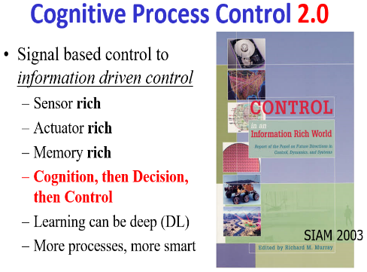
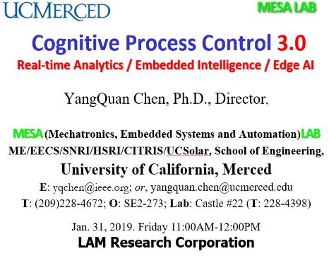
1. Introduction
Cognitive Process Control 2.0 and 3.0

Slide 9
1. Introduction
CPC and IAI (Industrial AI) for Industry 4.0
Cloud computing
Deep learning
Data analytics
Big data
Industry 4.0
Disruptive technologies
Cognitive process control
Industrial artificial Intelligence
Cyber physical systems (CPS)
A unified, detailed, and realistic representation of the CPS is required for Industry 4.0 Modelling, Analysis, and Design
(M.A.D) Methodology
Digital Twin

Slide 10
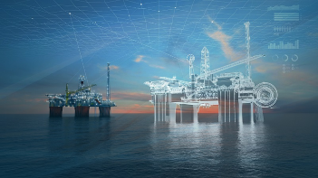
2. Digital Twin
What is Digital Twin?
Digital Twin
Virtual representation of a physical system
Multidomain simulation tools
Data driven capabilities
Real time updatable status of the system

Slide 11
2. Digital Twin
Digital Twin initial concept @ 2003
Grieves 2003, Michigan university, Product Lifecycle Management course
“DT is a virtual, digital equivalent to a physical product” [5]
Challenges at 2003:
Cheap and rich sensing
No massive Internet of Things (IoT)
No edge computing
Massive AI techniques and software

Slide 12
2. Digital Twin
Evolution of DT concepts:
Definition | Authors | Year
DT is a virtual, digital equivalent to a physical product | Grieves [5] | 2003
an integrated Multiphysics, multiscale, probabilistic simulation of an as-built vehicle or system that uses the best available physical models, sensor updates, fleet history, etc., to mirror the life of its corresponding flying twin | NASA [10] | 2012
Dynamic virtual representation of a physical object or system, usually across multiple stages of its lifecycle. It uses real-world data, simulation or machine learning models, combined with data analysis, to enable understanding, learning, and reasoning. | IBM [8] | 2019
Software representations of assets and processes that are used to understand, predict, and optimize performance in order to achieve improved business outcomes. | GE Digital [9] | 2020
DT are precise, virtual copies of machines or systems driven by data collected from sensors in real time, these sophisticated computer models mirror almost every facet of a product, process or service. | Tao [12] | 2020

Slide 13
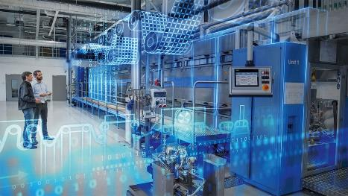
2. Digital Twin
“A Digital Twin is the combination of multiple, individual, and detailed simulation models (continuous, discrete, hybrid), where its interconnection represents the dynamics of a complex system, which is updated periodically (windowed or real time ) with the system information in order to reflect the system current status as well as predict its future behavior and possible faults ”.
^{MESA Lab, UC Merced}
Virtual representation of the system
High detail modelling
System life cycle estimation
Interconnected system dynamic
IoT and edge computing data acquisition

Slide 14
2. Digital Twin
DT concept structure
Individual component modelling
IoT and edge Computing
Instance and aggregation
Open for AI and machine learning

Slide 15
2. Digital Twin
DT features

Slide 16
2. Digital Twin
DT components

Slide 17
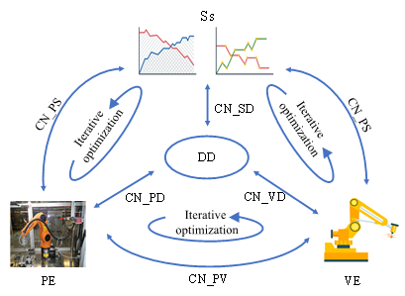
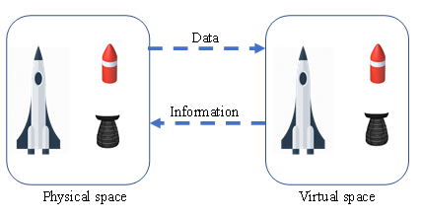
2. Digital Twin
DT architectures
Three dimension DT
(per Grieves, 2003)
Five dimensions of DT [13]

Slide 18
2. Digital Twin
4 levels of Digital Twin [14]
Level | System modelling | Physical system | System interaction | Smart capabilities | Features
I | Digital Twin Environment | Not built | Not built | Not apply | Preliminary design
II | DT environment based on the real system | Operating standalone | Non-real time data acquisition | No | Performance analysis and system status
III | DT environment with monitoring interface and fault detection Capabilities | Operating standalone with supervision systems | Real time data acquisition | Limited | Data analytics, fault detection, prognosis
IV | DT environment with monitoring interface, and adaptive behavioral learning | Operating in the loop with the DT virtual environment | Real time data acquisition and smart control | Total | Data analytics, Fault detection, prognosis, Automated recommendations, Automated actions over the physical system

Slide 19
2. Digital Twin
4 levels of Digital Twin [14]
Level | System modelling | Physical system | System interaction | Smart capabilities | Features
I | Digital Twin Environment | Not built | Not built | Not apply | Preliminary design
II | DT environment based on the real system | Operating standalone | Non-real time data acquisition | No | Performance analysis and system status
III | DT environment with monitoring interface and fault detection Capabilities | Operating standalone with supervision systems | Real time data acquisition | Limited | Data analytics, fault detection, prognosis
IV | DT environment with monitoring interface, and adaptive behavioral learning | Operating in the loop with the DT virtual environment | Real time data acquisition and smart control | Total | Data analytics, Fault detection, prognosis, Automated recommendations, Automated actions over the physical system
Most of our MESALab
Systems are here

Slide 20
2. Digital Twin
Challenges of Digital Twin
Subsystems Modelling
Finite elements
Sensor integration and data fusion
Real time data for multiphysics modelling
High computational power
Communication protocols
Behavioural matching
Makes the DT works as the real system and update its behaviour
Lack of system knowledge (experience, equations)
Multiphysics
Multiple components providers
Degradation of the system components
Level of detail

Slide 21
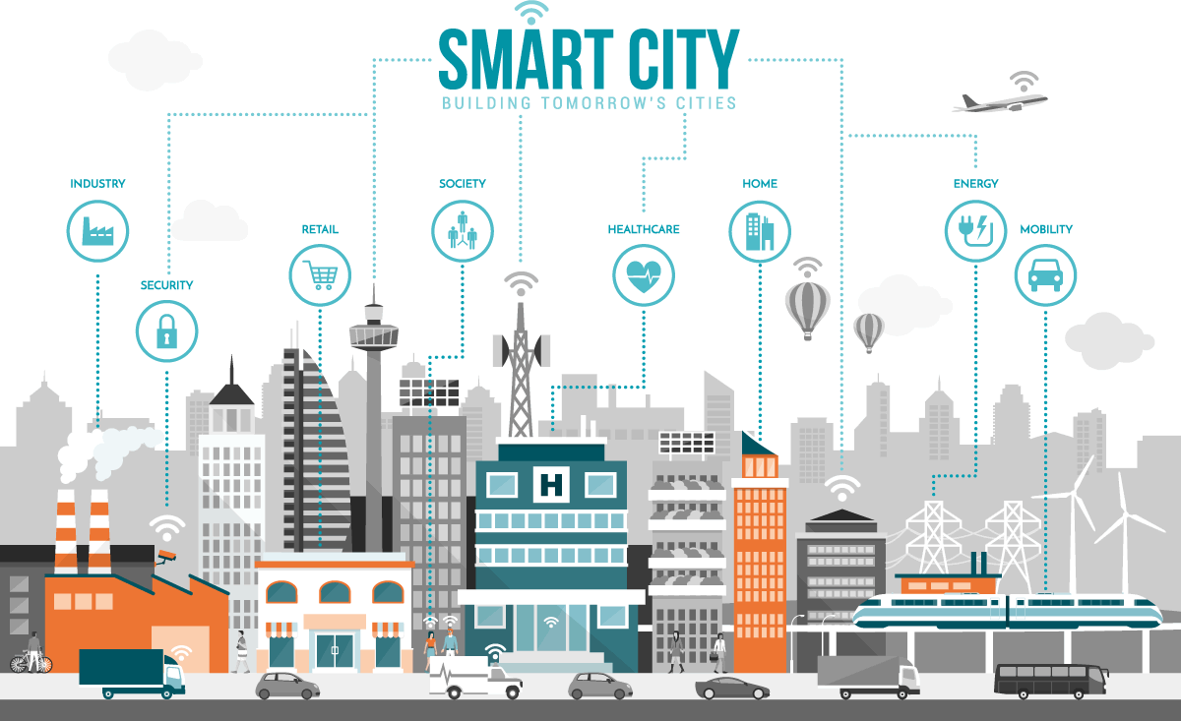
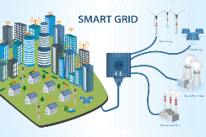
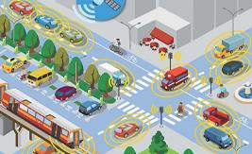

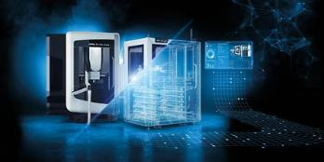
2. Digital Twin
DT Applications
Smart city
Smart grid
Smart transportation
Smart manufacturing
CNC machines DT

Slide 22
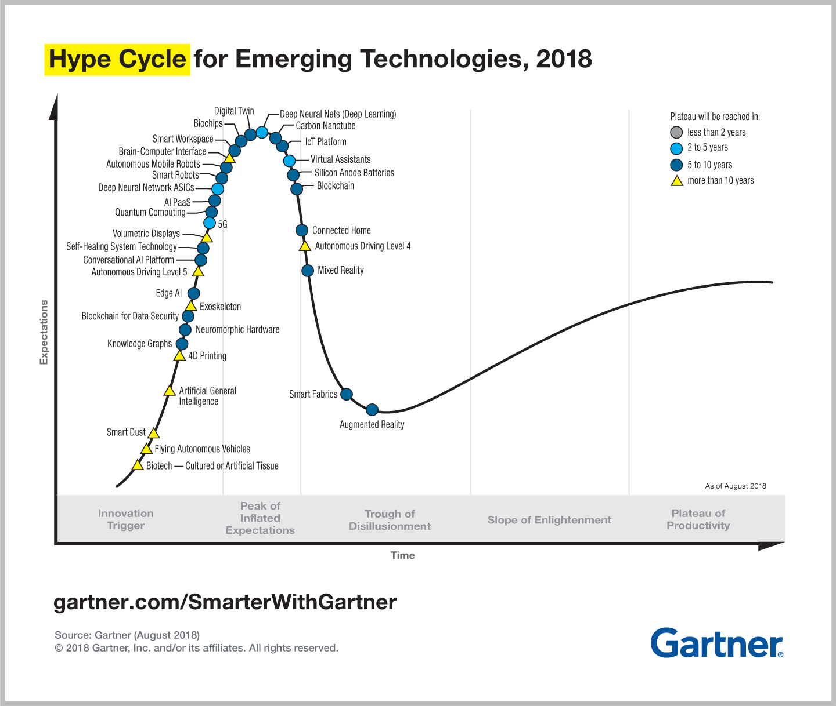
2. Digital Twin
DT Gartner Hype Curve 2018
Peak of inflated expectations (2018)
Plateau of productivity between 5 to 10 years
https://www.gartner.com/smarterwithgartner/5-trends-emerge-in-gartner-hype-cycle-for-emerging-technologies-2018/

Slide 23
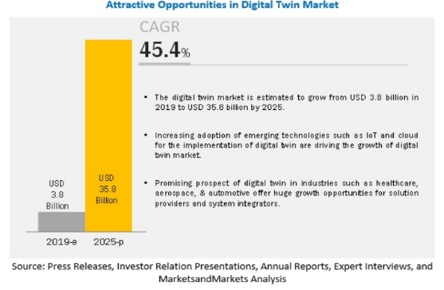
2. Digital Twin
Expectations about DT
Key player companies:
General Electric
IBM
PTC
Microsoft
Siemens AG
ANSYS
Oracle
https://www2.deloitte.com/us/en/insights/focus/tech-trends/2020/digital-twin-applications-bridging-the-physical-and-digital.html#endnote-10
https://www.marketsandmarkets.com/Market-Reports/digital-twin-market-225269522.html

Slide 24
2. Digital Twin
Smart control engineering and DT
NSF Smart and Autonomous systems (S&AS) [24]
Notes:
Smart cities, transportation, grid, UAV, UGV, all autonomous

Slide 25
2. Digital Twin
Cognitive Process Control and DT
Awareness of process health
Decision making support and health alerts
Learning from past
Data driven analysis to closed loop systems
Leverage
CPC features
Through updated
Virtual representations
Digital Twin
Notes:
Smart cities, transportation, grid, UAV, UGV, all autonomous

Slide 26
2. Digital Twin
Enabled capabilities for Control Engineering
Smart control system design
Control performance assessment
Self optimizing control
Prognosis and fault detection
Parallel sensing and control

Slide 27
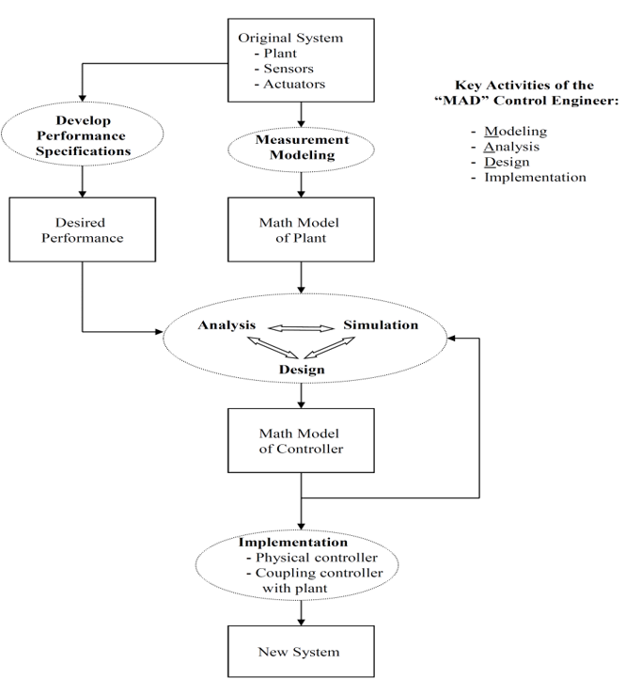
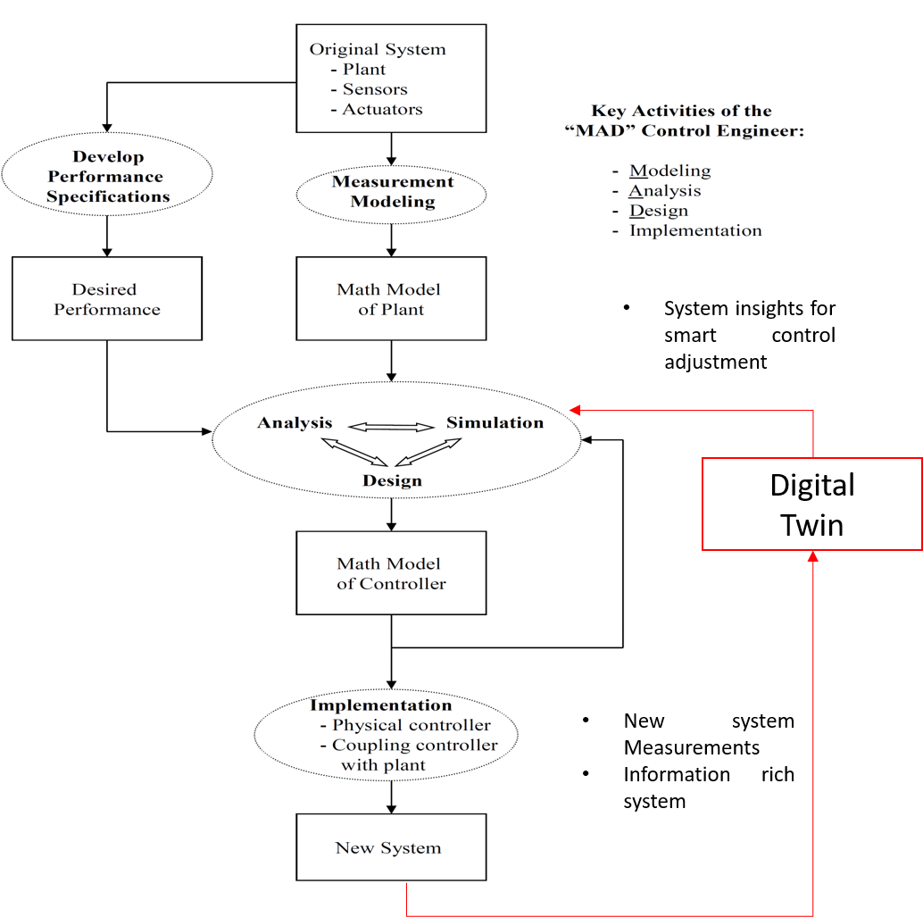
2. Digital Twin
Smart control engineering: MAD methodology
Classic MAD
MAD with DT
M: Modelling
A: Analysis
D: Design
MAD Credit:
Kevin L. Moore
http://mechatronics.ucmerced.edu/madbook

Slide 28
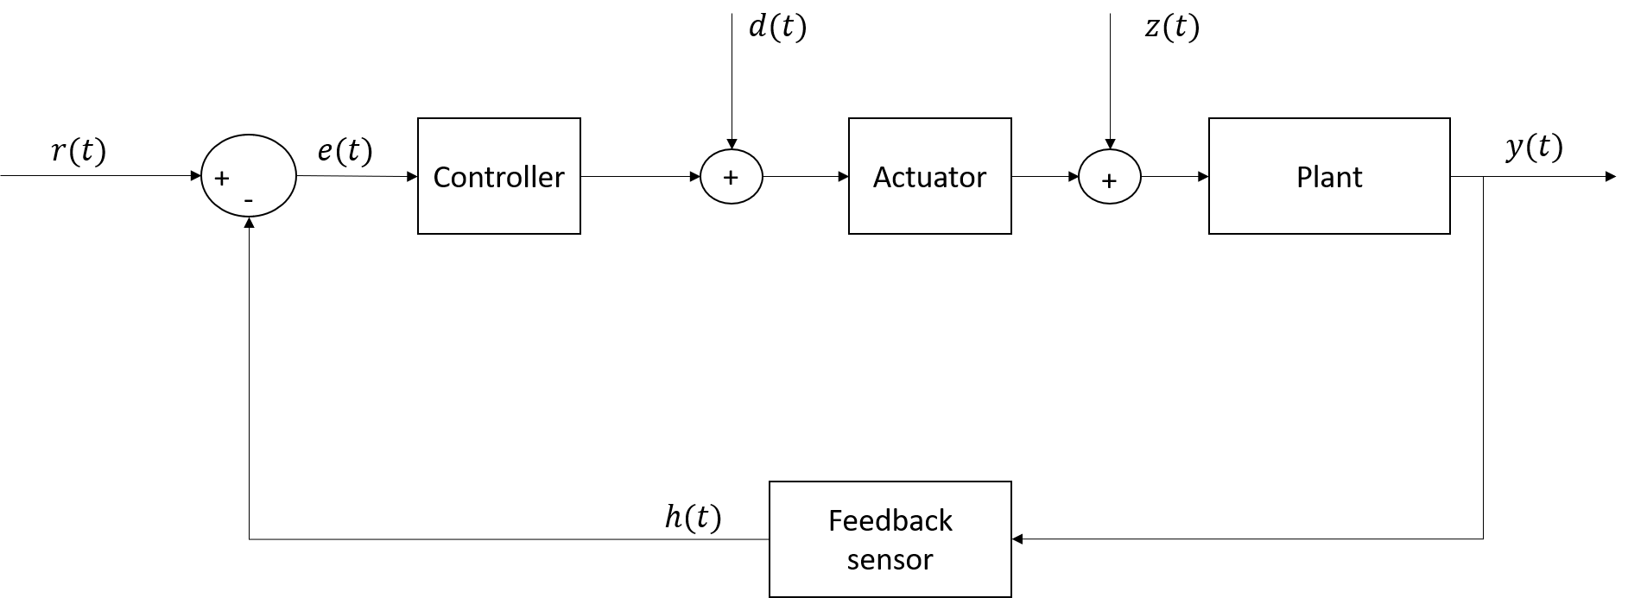
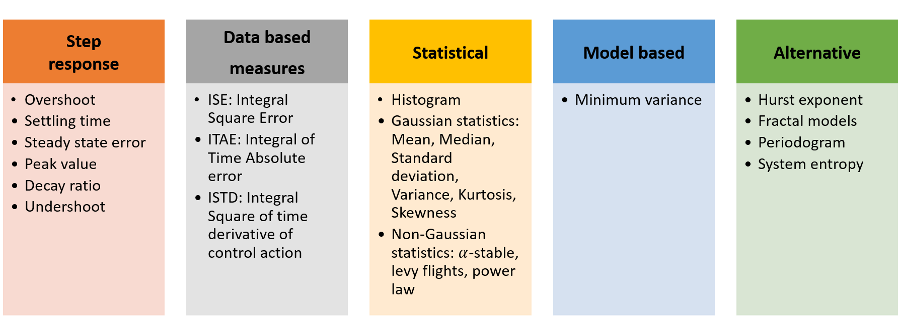
2. Digital Twin
Control Performance Assessment (CPA)
Measuring the control quality of a closed loop system against different control methodologies
Key Performance Indices (KPI)
Controller benchmarks (PID, MPC)

Slide 29
2. Digital Twin
UC Merced MESA Lab Smart Control Engineering goals:
Define a systematic methodology for design and implementation of DT on real systems for control engineering
Make smarter cognitive process control (CPC) supported on DT models and disruptive technologies
Employ fractional order signal processing (FOSP) based on fractional calculus (FC) into the digital twin modelling, data analytics, deep learning, and all disruptive technologies in the process.

Slide 30
Part 2: Building a DT from scratch

Slide 31





3. Building a DT from scratch
Steps to build a DT
4. DT assembly
And
Behavioral
matching
2. System
Documentation
1. Target system definition
3. Multidomain Simulation
5. DT validation
And deployment

Slide 32
3. Building a DT from scratch
1. Target system definition scenarios
Scenario 1
Scenario 2
CAD/CAM design
Digital Twin level I
Physical system
Standalone operation
System conceptualization
Multiphysical simulation
Used for system initial design before manufacturing
Closed loop stable
Controllers, sensors, actuators
Available data streams
Minimum requirement to be in DT level II

Slide 33
3. Building a DT from scratch
2. System documentation
Relevant documents about the process like:
Control algorithms employed (PID, MPC, SS) and its digital implementation
Sensors and actuators datasheets
Troubleshooting and problems records
Cumulative experience of the system engineers and operators
Data streams collection, analysis and filtering.

Slide 34
3. Building a DT from scratch
3. Multidomain simulation
Modelling methods
Data driven
models
Hybrid-based
modelling
Physics-based
modelling
Linear degradation model
Deep learning model
Data/model estimation
Kalman filter
State observers
Thermal, fluids, electric, multibody
Simulink, SimScape
Finite elements analysis
CAD cosimulation
  (PSpice, MSC-ADAMS)

Slide 35





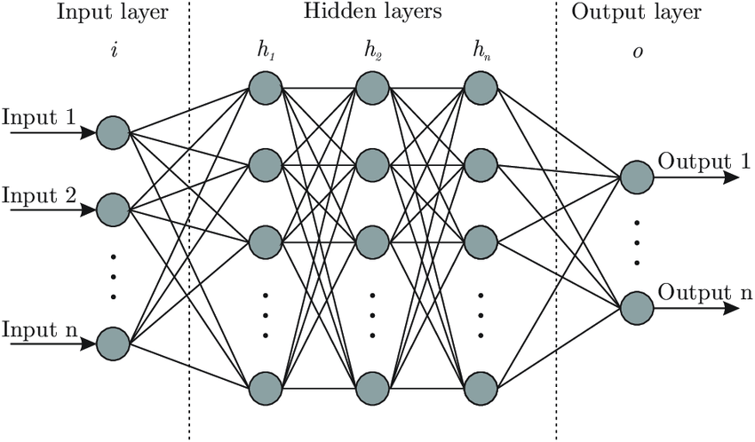
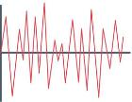

3. Building a DT from scratch
3. Multidomain simulation
Data
streams
Output
Digital Twin

Slide 36

3. Building a DT from scratch
4. DT assembly and behavioural matching
“Find the parameters of each subsystem composing the Digital Twin in order to fit its complete system dynamics, coinciding match with the real state of the physical system”
DT subsystems
parameters
Physical system
I/O Data
Optimized
DT subsystems
parameters
Optimization
loop
Digital Twin
DT output
I/O error minimization

Slide 37
3. Building a DT from scratch
4. DT assembly and behavioural matching
Required level of detail of the Digital Twin
Both input and output data of the Digital Twin must be employed simultaneously
Experience about the system is required to constraining optimization parameters
High computer power consumption
Behavioural matching is performed in open or closed loop?
Choose a suitable optimization algorithm and cost functions
    Metaheuristic: Genetic algorithm, Cuckoo search
    Gradient descend
    Simplex, linear and quadratic programming
    Indices: ISE, ITAE, IAE

Slide 38
3. Building a DT from scratch
5. DT Validation and Deployment
Validate the DT behaviour for multiple datasets (offline)
Supervisory interface for real system data management, visualization and DT visualization
Real time operation of DT in parallel with the real system (online)
Behavorial matching and DT enabling capabilities available

Slide 39
Part 3: Show and Tell
Peltier SISO System

Slide 40
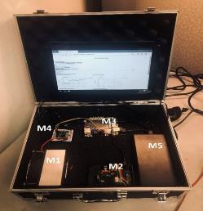
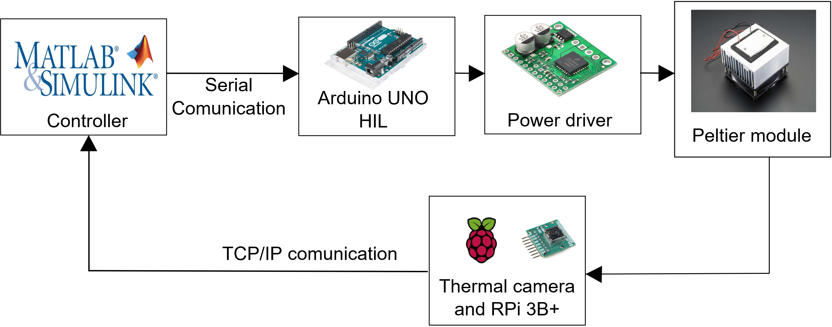
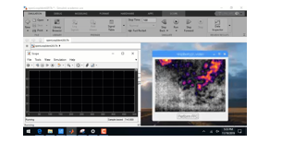
4. Study case: SISO Peltier system
Peltier temperature control module with visual feedback
System features
Edge computing temperature control platform
Real-time infrared temperature feedback
Real-time hardware in the loop (HIL) configuration with Matlab (open to multiple control strategies)
Temperature range: 0 to 100 °C
Portable with 4 hours duration battery
Dimensions: (15x20x10) cm

Slide 41
4. Study case: SISO Peltier system
Step 1: operative physical system
Operation
Closed loop PID control
Communication protocols: serial communication and TCP/IP
System components
Peltier module for heating cooling
Environment temperature sensing
Infrared thermal camera
Power driver
LattePanda Board
Matlab Simulink PID control
Open loop stable

Slide 42
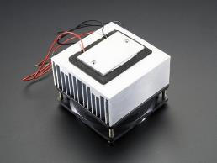
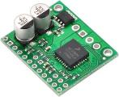
4. Study case: SISO Peltier system
Step 2: system documentation
Peltier module uses thermoelectric effect to produce temperature change at an electrified junction of two conductors.
The module is controlled by Arduino board which generates PWM signal for the power driver.
The driver based on received PWM value (from -255 to 255) manages the power applied to the Peltier module. Power specs: 15v 5A max
Peltier module
Power driver

Slide 43
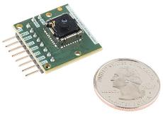
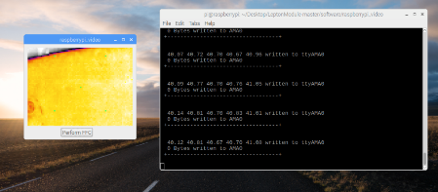
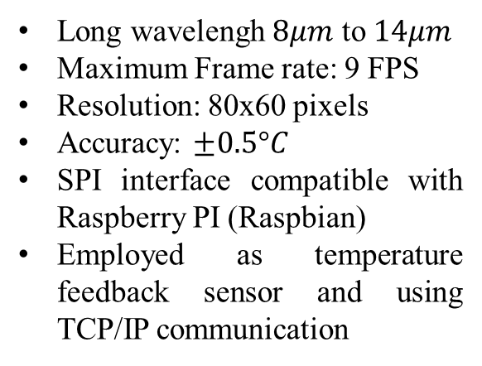
4. Study case: SISO Peltier system
Step 2: System documentation
FLIR Lepton infrared camera
Long wavelengh $8μm$ to $14μm$
Maximum Frame rate: 9 FPS
Resolution: 80x60 pixels
Accuracy: $±0.5°C$
SPI interface compatible with Raspberry PI (Raspbian)
Employed as temperature feedback sensor and using TCP/IP communication

Slide 44
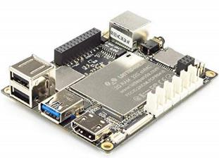

4. Study case: SISO Peltier system
Step 2: system documentation
LattePanda board
5 inch full windows-based edge computer
Windows 10 64 bits
Intel Atom microprocessor and 4GB of RAM
Arduino Leonardo board included
Runs matlab in Hardware in the loop configuration (HIL)
Central edge computer device for the SISO Peltier system

Slide 45
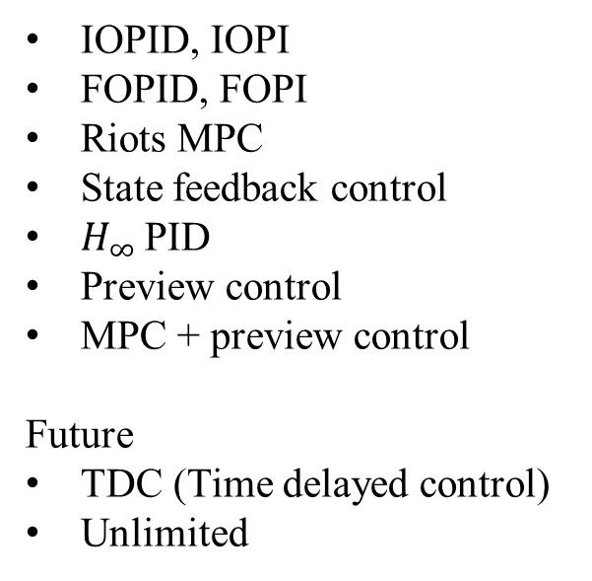
4. Study case: SISO Peltier system
Step 2: system documentation
Control techniques employed for SISO Peltier in MESA Lab
IOPID, IOPI
FOPID, FOPI
Riots MPC
State feedback control
$H_{∞}$ PID
Preview control
MPC + preview control
Future
TDC (Time delayed control)
Unlimited
Notes:
The system should be observable and controllable for RIOTS implementation

Slide 46
4. Study case: SISO Peltier system
Step 3: multidomain simulation
Domains
Electrical
Thermal
Fluids
Digital
Power driver (PWM)
Battery
Semiconductor joint of Peltier
PID controller implementation
Arduino interface for data acquisition and control action application
Infrared thermal
camera
Heat transfer in the Peltier
Heatsink
Electric to thermal energy conversion
Level of details?
Air cooling fan
for the heatsink

Slide 47


4. Study case: SISO Peltier system
Step 3: multidomain simulation
Domains
Electrical
Thermal
Fluids
Digital
Power driver (PWM)
Battery
Semiconductor joint of Peltier
PID controller implementation
Arduino interface for data acquisition and control action application
Infrared thermal
camera
Heat transfer in the Peltier
Heatsink
Electric to thermal energy conversion
Software tools
Air cooling fan
for the heatsink

Slide 48
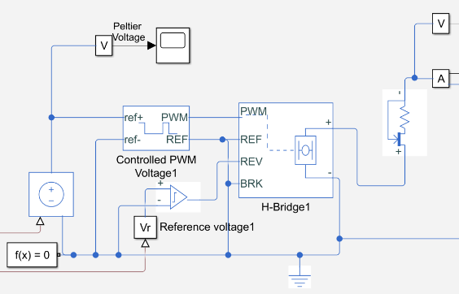
4. Study case: SISO Peltier system
Step 3: electrical domain
Power driver
Arduino
PWM
Current
limiter
Current
Sense
comparator

Slide 49
4. Study case: SISO Peltier system
Step 3: electrical domain specifications
Component | Features
Power driver | Input: 0v to 5v PWM signal Output: 0 to 12v PWM signal
Current limiter | Max current: 5A (Power driver)
Arduino PWM generator | PWM frequency: 500Hz Input-output scaling: 5V
Current sense comparator | Turning sense voltage threshold: 0.1v
Electrical simulation in SimScape runs in RMS average values mode to increase simulation speed
Information taken from the components datasheets

Slide 50
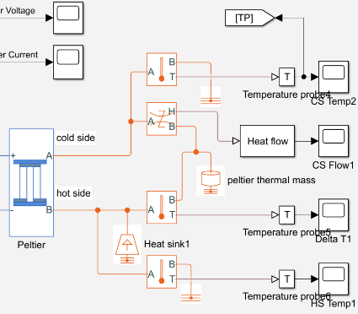
4. Study case: SISO Peltier system
Step 3: thermal domain
Cold side
Peltier
module
Peltier
Thermal mass
Heat sink
(Ideal)
Hot side

Slide 51
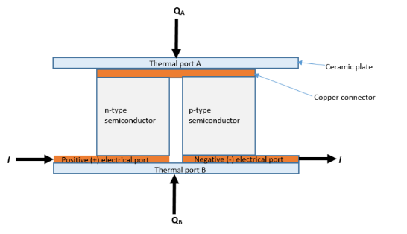
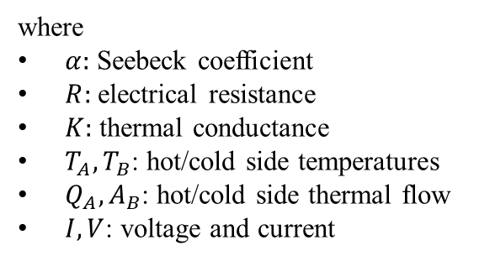
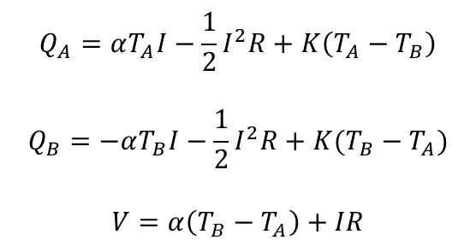
4. Study case: SISO Peltier system
Step 3: Peltier thermo electric model
Cold Side
$$Q_{A}=αT_{A}I−\frac{1}{2}I^{2}R+K\left(T_{A}−T_{B}\right)$$
$$Q_{B}=−αT_{B}I−\frac{1}{2}I^{2}R+K(T_{B}−T_{A})$$
$$V=α\left(T_{B}−T_{A}\right)+IR$$
where
$α:$ Seebeck coefficient
$R:$ electrical resistance
$K:$ thermal conductance
$T_{A},T_{B}$: hot/cold side temperatures
$Q_{A},A_{B}$: hot/cold side thermal flow
$I,V$: voltage and current
Hot Side
https://www.mathworks.com/help/physmod/sps/ref/peltierdevice.html

Slide 52


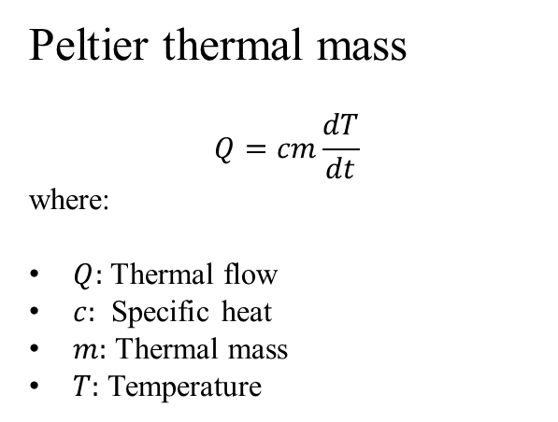
4. Study case: SISO Peltier system
Step 3: Heat sink and thermal mass
Peltier thermal mass
$$Q=cm\frac{dT}{dt}$$
where:
$Q:$ Thermal flow
$c:$ Specific heat
$m:$ Thermal mass
$T:$ Temperature
Peltier heat sink
Ideal temperature source 295K (22°C)

Slide 53
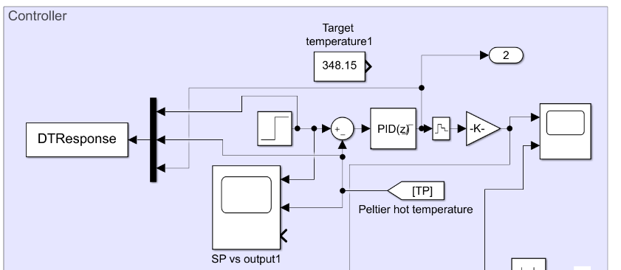
4. Study case: SISO Peltier system
Step 3: Digital Domain
PID controller

Slide 54
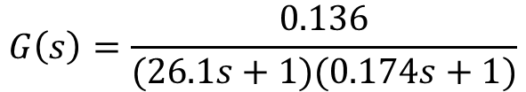
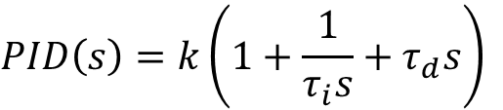

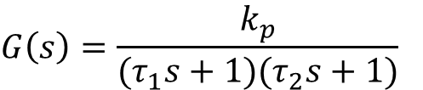

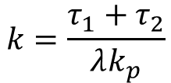
4. Study case: SISO Peltier system
Step 3: Digital domain PID controller
Controller: PID with anti windup
$$G\left(s\right)=\frac{0.136}{(26.1s+1)(0.174s+1)}$$
$$PID\left(s\right)=k\left(1+\frac{1}{τ_{i}s}+τ_{d}s\right)$$
Internal Model Control technique (IMC)
$$G\left(s\right)=\frac{k_{p}}{(τ_{1}s+1)(τ_{2}s+1)}$$
$$k=\frac{τ_{1}+τ_{2}}{λk_{p}}$$
$$τ_{d}=\frac{τ_{1}τ_{2}}{τ_{1}+τ_{2} }$$
$$τ_{i}=τ_{1}+τ_{2}$$
Notes:
The system should be observable and controllable for RIOTS implementation

Slide 55
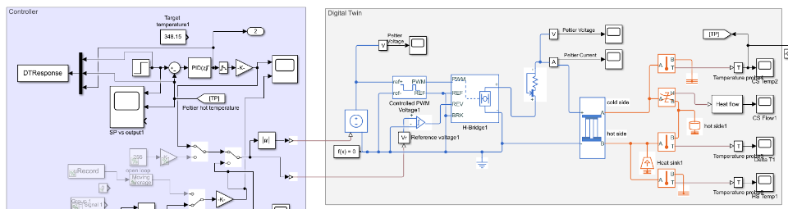
4. Study case: SISO Peltier system
Step 3: DT assembly

Slide 56
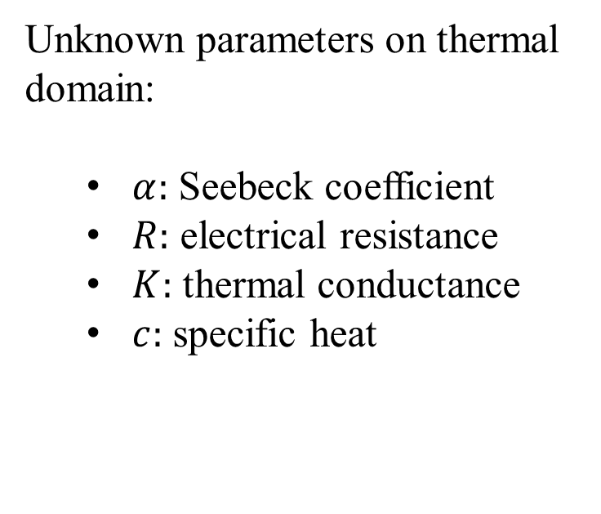
4. Study case: SISO Peltier system
Step 4: behavioral matching
Options for finding parameters and behavioural matching
Unknown parameters on thermal domain:
  $α:$ Seebeck coefficient
  $R:$ electrical resistance
  $K:$ thermal conductance
  $c:$ specific heat
1 datasheet review
2 Direct measurement
3 Data Driven Optimization

Slide 57
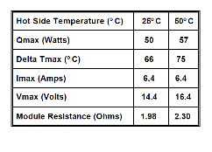
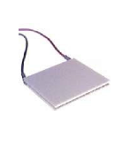
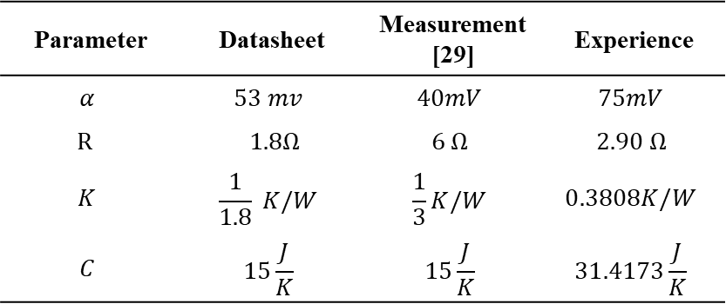
4. Study case: SISO Peltier system
Step 4: behavioral matching
TEC1-12706 Peltier module
Parameter | Datasheet | Measurement [29] | Experience
$$α$$ | $$53 mv$$ | $$40mV$$ | $$75mV$$
$$R$$ | $1.8Ω$ | $$6 Ω$$ | $$2.90 Ω$$
$$K$$ | $$\frac{1}{1.8} K/W$$ | $$\frac{1}{3}K/W$$ | $$0.3808K/W$$
$$C$$ | $$15\frac{J}{K}$$ | $$15\frac{J}{K}$$ | $$31.4173\frac{J}{K}$$
Which are the right parameters?

Slide 58
4. Study case: SISO Peltier system
Step 4: behavioral matching for 50°C setpoint
Input output matching

Slide 59
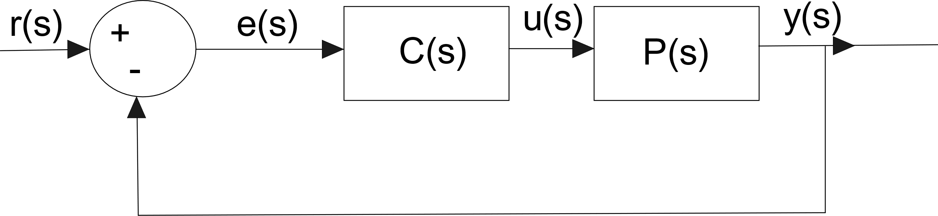
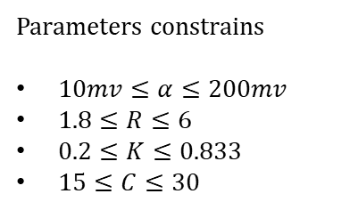
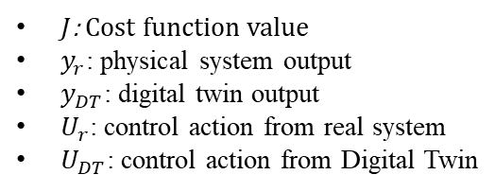

4. Study case: SISO Peltier system
Step 4: behavioral matching
Genetic algorithm (closed-loop operation)
$J=\int_{0}^{T}{{\left(y_{r}−y_{DT}\right)}^{2}}+{\left(U_{r}−U_{DT}\right)}^{2}dt$
Parameters constrains
$10mv≤α≤200mv$
$1.8≤R≤6$
$0.2≤K≤0.833$
$15≤C≤30$
$J$: Cost function value
$y_{r}$: physical system output
$y_{DT}$: digital twin output
$U_{r}$: control action from real system
$U_{DT}$: control action from Digital Twin
Notes:
Why closed loop? Because in real life, data cames from closed loop systems

Slide 60

4. Study case: SISO Peltier system
Step 4: behavioral matching GA results
Execution parameters:
100 generations
initial pool 3 parents
Mutation probability 90%
Parameter | GA
$$α$$ | $$35.8mv$$
$$R$$ | $3.35Ω$
$$K$$ | $$0.2882K/W$$
$$C$$ | $$15\frac{J}{K}$$

Slide 61
4. Study case: SISO Peltier system
Step 4: behavioral matching GA results

Slide 62




4. Study case: SISO Peltier system
Step 4: behavioral matching GA results
Execution parameters:
100 generations
initial pool 3 parents
Mutation probability 90%
Parameter | GA
$$α$$ | $$51.6mv$$
$$R$$ | $2.0227Ω$
$$K$$ | $$0.3414K/W$$
$$C$$ | $$41.88\frac{J}{K}$$
Different cooling dynamics

Slide 63
4. Study case: SISO Peltier system
Step 4: behavioral matching (BM) GA results
GA optimization results distribution for heating BM at 50°C
Notes:
Multiple solutions to reach the desired operating point. By experience maybe the mean of each boxplot is the most accurate result to choose.

Slide 64

4. Study case: SISO Peltier system
Step 5: DT validation and deployment
Supervisory interface
Online DT execution
Behavioural matching
CPA, prognosis (next update)

Slide 65

4. Study case: SISO Peltier system
Step 5: DT validation and deployment
Behavioural matching

Slide 66

4. Study case: SISO Peltier system
Step 5: DT validation and deployment
TCP/IP client server parallel DT configuration

Slide 67

4. Study case: SISO Peltier system
Demo: DT SISO Peltier setpoint 50°C

Slide 68

4. Study case: SISO Peltier system
Demo: Digital Twin of SISO Peltier system stepped responses

Slide 69

4. Study case: SISO Peltier system
Demo: Digital Twin behavioral matching SP: 50°C

Slide 70
Conclusions and future work
A methodological framework has been proposed to build a Digital Twin for a closed loop system from scratch for SISO Peltier system with real time temperature visual feedback
A behavorial matching of the Digital Twin with the real system is required to replicate the real system behaviour in the digital world representation considering the current state of the system
The digital twin of the system keeps running online with the system in order to validate the dynamics of the digital twin in the presence of real data
The Digital Twin goes through a detailed review of each component and subsystem in order to recreate the system behavior using multidomain simulation
Digital Twin is a detailed virtual representation of a real system, which is an emerging technology with significant benefits towards Industry 4.0
The SISO Peltier system exhibits a different heating and cooling dynamics, therefore and adaptive parameter compensation has to be included in the DT to represent both dynamic behaviors adequately

Slide 71
Conclusions and next steps
Next steps
Improved optimization algorithms (nesterov, gradient descend)
Fractional order dynamics
The level of details for the Digital Twin of SISO peltier system can be extended as well as enabling smartness for cognitive process control:
Improve the Multiphysics simulation model cover the missing simulation domains
Perform prognosis, fault detection and smart control modules for the real system and the Digital Twin
Consider Randomness and stochasticity from communication delays and noise sources in feedback loop
Encourage the use of Digital Twin as the starting point to make “Smarter factories” and “Smart agents”
Heat sink fluid simulation
Thermal camera random noise characterization
More real time analytics
Fault detection and prognosis
System self awareness

Slide 72
Future works
Digital Twin for AI brains training and control
Reinforced learning in real world
One system
Repetitive learning process
May take long time according to the desired behaviour
Control action
reward
Physical system
I/O Data
AI
Reinforced
learning
Real system
System
response

Slide 73

Future works
Digital Twin for AI brains training and control
Reinforced learning with Digital Twin plus real world physics
Control action
reward
AI
Reinforced
learning
Physical system
I/O Data
…
System
response
Real system
DT 1
DT 2
DT 3
DT n

Slide 74
Conclusions and next steps
2020 Digital Twin show-and-tell series:
Show and tell | System | Date | Speaker
Ball and plate system | Motion controls | July 5 2020 | Mauricio
MIMO 2x2 Peltier system | Process control | August 10 2020 | Carlos and Jairo
PHELP system (MIMO 16x16) | Process control | September 2020 | Carlos
Fractional order dynamometer | Motion controls | October 2020 | Mauricio
Peltier NCS system | Cyber physical systems | November 2020 | Jairo
DT summary |  | December 2020

Slide 75




Pixel Heating Experiment Learning Platform (PHELP)
MESA Lab Research Capabilities for DT
16x16 MIMO temperature uniformity control system for education and research.
Pixel Neighbourhood based temperature sampling
Matlab/ Arduino hardware in the loop configuration (HIL) for control strategies real-time tuning
(P1)
(P1)
(P1)
(P2)

Slide 76




Fractional Horsepower Dynamometer
MESA Lab Research Capabilities for DT
System Features:
Fractional-order dynamics motion control platform
Hardware in the loop interaction with Matlab/Simulink/LabVIEW
Real-time fast prototyping coding
Position and velocity regulation and tracking tasks
Real-time disturbance stimulus

Slide 77





MESA Lab NCS Temperature Control System
Cyber part
Physical part
Edge computing based server
System Features:
Closed-loop control system through internet network
Remote control from anywhere worldwide
Stochastic random communication delay
Web browser remote client
interface
Peltier temperature control module with visual feedback

Slide 78


Towards Digital Twin Integration
For further information, publications, and videos visit:
theedgeai.com and http://mechatronics.ucmerced.edu/

Slide 79
Take home message
The Digital Twin is:
“The starting point on the smart and disruptive technology evaluation and implementation”
for the manufacturing transformation into an
Industry 4.0 based on reliable system dynamics

Slide 80
References
C. Strategies, “Artificial Intelligence for Industrial Applications,” tech. rep., CloudPulse Strategies, 2017.
Gartnet Inc., “5 Trends Emerge in the Gartner Hype Cycle for Emerging Technologies, 2018,” 2018.
D. consulting, “Digital Twins,” 2020.
MarketsandMarkets Research Private Ltd, “Digital Twin Market by Technology, Type (Product, Process, and System), Industry (Aerospace & Defense, Automotive & Transportation, Home & Commercial, Healthcare, Energy & Utilities, Oil & Gas), and Geography - Global Forecast to 2025,” 2020.
M. Grieves, “Digital Twin : Manufacturing Excellence through Virtual Factory Replication This paper introduces the concept of a A Whitepaper by Dr . Michael Grieves,” White Paper, no. March, 2014.
M. Grieves and J. Vickers, Digital Twin: Mitigating Unpredictable, Undesirable Emergent Behavior in Complex Systems, pp. 85–113. Cham: Springer International Publishing, 2017.
M. Inc, “What is a digital twin?,” 2019.
IBM, “Digital twin: Helping machines tell their story,” 2020.
GE Digital, “What is a digital twin?,” 2019.
D.S. Stargel and E. H. Glaessgen, “The Digital Twin Paradigm for Future NASA and U.S. Air Force Vehicles E.,” in 53rd Structures, Structural Dynamics, and Materials Conference: Special Session on the Digital Twin, pp. 1–14, 2012.
C. Dufour, Z. Soghomonian, and W. Li, “Hardware-in-the-Loop Testing of Modern On-Board Power Systems Using Digital Twins,” SPEEDAM 2018 - Proceedings: International Symposium on Power Electronics, Electrical Drives, Automation and Motion, pp. 118–123, 2018.
F. Tao and Q. Qi, “Make more digital twins,” Nature, vol. 573, no. 7775, pp. 490–491, 2019.
F. Tao, M. Zhang, Y. Liu, and A. Y. Nee, “Digital twin driven prognostics and health management for complex equipment,” CIRP Annals, vol. 67, no. 1, pp. 169–172, 2018.
A. M. Madni, C. C. Madni, and S. D. Lucero, “Leveraging Digital Twin Technology in Model-Based Systems Engineering,” Systems, pp. 1–13, 2019.

Slide 81
References
M. Farsi, A. Daneshkhah, A. Hosseinian-Far, and H. Jahankhani, Internet of Things Digital Twin Technologies and Smart Cities. Springer, 2020.
F. Zhu, Z. Li, S. Chen, and G. Xiong, “Parallel Transportation Management and Control System and Its Applications in Building Smart Cities,” IEEE Transactions on Intelligent Transportation Systems, vol. 17, no. 6, pp. 1576–1585, 2016.
P. Vicuna, S. Mudigonda, C. Kamga, K. Mouskos, and C. Ukegbu, “A generic and flexible geospatial data warehousing and analysis framework for transportation performance measurement in smart connected cities,” Procedia Computer Science, vol. 155, no. 2018, pp. 226–233, 2019.
J. Schmalzel, F. Figueroa, J. Morris, S. Mandayam, and R. Polikar, “An architecture for intelligent systems based on smart sensors,” Conference Record - IEEE Instrumentation and Measurement Technology Conference, vol. 1, no. 4, pp. 71–75, 2004.
A. H. Bagdadee, Z. Hoque, L. Zhang, A. H. Bagdadee, Z. Hoque, and L. Zhang, “IoT Based Wireless Sensor Network for Power Quality Control in IoT Based Wireless Sensor Smart Network for Power Quality Control in Grid Smart Grid,” vol. 00, no. 2019, 2020.
P. Zhang, F. Li, and N. Bhatt, “Next-generation monitoring, analysis, and control for the future smart control center,” IEEE Transactions on Smart Grid, vol. 1, no. 2, pp. 186–192, 2010.
M. Rahimi, M. Songhorabadi, and M. H. Kashani, “Fog-based smart homes: A systematic review,” Journal of Network and Computer Applications, vol. 153, p. 102531, 2020.
B. J. Chang and J. M. Chiou, “Cloud Computing-Based Analyses to Predict Vehicle Driving Shockwave for Active Safe Driving in Intelligent Transportation System,” IEEE Transactions on Intelligent Transportation Systems, vol. 21, no. 2, pp. 852–866, 2020.
L. Chen, Y. He, J. Chen, Q. Li, and Q. Zou, “Transforming a 3-D Li- DAR Point Cloud into a 2-D Dense Depth Map Through a Parameter Self- Adaptive Framework,” IEEE Transactions on Intelligent Transportation Systems, vol. 18, no. 1, pp. 165–176, 2017.
NSF, “Smart and Autonomous Systems (S&AS),” 2018.
YangQuan Chen, “Cognitive Process Control,” 2012.
D. Xue and Y. Chen, Modeling, Analysis and Design of Control Systems in MATLAB and Simulink. WORLD SCIENTIFIC, 2014.
P. D. Doma´nski, Control Performance Assessment: Theoretical Analyses and Industrial Practice. Studies in Systems, Decision and Control, Springer International Publishing, 2019.
E. J. Moya and E. Baeyens, “Control Performance Assessment : A General Survey,” No. June 2014, 2010.
V. I. Kubov and Y. Y. Dymytrov, “LTspice-model of Thermoelectric Peltier-Seebeck Element,” no. April, 2016, doi: 10.13140/RG.2.1.1372.2002.

Slide 82
Acknowledgements
Thanks for the multiple discussion sessions, constructive critics, suggestions, and valuable results
Dr Chen
Carlos
Derek
Mauricio

Slide 83


Thanks for your attention!

Slide 84






PID control
Technique: Integer Order PID controller (IMC)
Controller form
Tuning and results
Pros:
Simplified tuning
Robustness to random noise
Challenges
Optimal choose of $λ$
Windup effect, and RT camera random noise
Different heating and cooling dynamics
Future work
Optimal search of $λ$
Smith predictor

Slide 85






PID control
Technique: Integer Order PI controller (AMIGO)
Controller form
Tuning and results
Pros:
Simplified tuning for FO controllers
Ruled based
Challenges
Works only for FOPDT
Windup problem
Future work
Try other tuning techniques for
FOPDT systems
Optimization based techniques

Slide 86



PID control
Technique: Fractional Order PI controller (FMIGO)
Controller form
Tuning and results
Pros:
Simplified tuning for FO controllers
Ruled based
Challenges
Works only for FOPDT
Windup problem
Future work
Use more optimal tuning rules for FO
controller tuning and design
Validate robustness to disturbances

Slide 87





Model Predictive Control
Technique: RIOTS MPC
Controller form
Tuning and results
Pros:
Optimal based control
Constrained input/output
Challenges
Requires a model of the system
Future work
Introduce Rate Limit in RIOTS
More constraint control
http://mechatronics.ucmerced.edu/riots

Slide 88





Robust control
Technique: $H_{∞}$ PID tuning
Controller form
Tuning and results
Pros:
Robust optimal controller
Optimal dynamic response
Challenges
Choose the right convergence region
Future work
Looks for more optimal convergence
region

Slide 89
Domains
Electrical
Thermal
Fluids
Digital
Power driver (PWM)
Battery
Semiconductor joint of Peltier
PID controller implementation
Arduino interface for data acquisition and control action application
Infrared thermal
camera
Heat transfer in the Peltier
Heatsink
Electric to thermal energy conversion
Air cooling fan
for the heatsink

Slide 90
250
250
50
DT Experience
50
200
DT Datasheet
200
DT Measured
DT Experience
DT Experience
n
DT GA
45
DT Datasheet
150
)
45
DT Datasheet
o
150
Real
DT Measured
i
C
t
DT Measured
c
°
DT GA
n
(
a
100
o
100
Real
i
e
DT GA
l
t
40
c
r
o
u
40
Real
r
a
t
l
50
t
o
n
50
a
r
t
o
r
n
c
e
o
DT Experience
p
35
c
0
35
M
0
m
M
DT Datasheet
W
e
W
T
P
-50
DT Measured
P
-50
30
DT GA
30
-100
Real
-100
25
-150
25
-150
-200
-200
0
100
200
300
0
100
200
300
0
100
200
300
0
100
200
300
Time (s)
Time (s)
Time (s)
Time (s)

Slide 91
250
250
50
DT Experience
50
DT Datasheet
200
200
DT Measured
DT Experience
DT Experience
n
150
DT GA
45
DT Datasheet
150
)
45
DT Datasheet
o
Real
DT Measured
i
C
t
DT Measured
c
°
DT GA
n
(
a
100
o
100
Real
i
e
DT GA
l
t
40
c
r
o
u
40
Real
r
a
t
l
50
t
o
n
50
a
r
t
o
r
n
c
e
o
DT Experience
p
35
c
0
35
M
0
m
M
DT Datasheet
W
e
W
DT Measured
T
P
-50
P
-50
30
DT GA
30
-100
Real
-100
25
-150
25
-150
-200
-200
0
100
200
300
0
100
200
300
0
100
200
300
0
100
200
300
Time (s)
Time (s)
Time (s)
Time (s)

